Slide 1
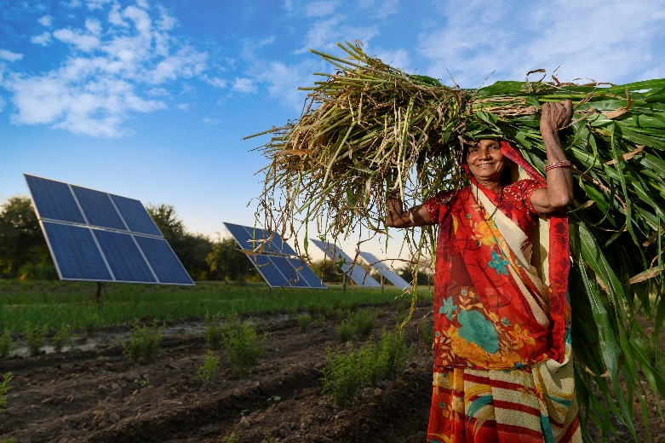
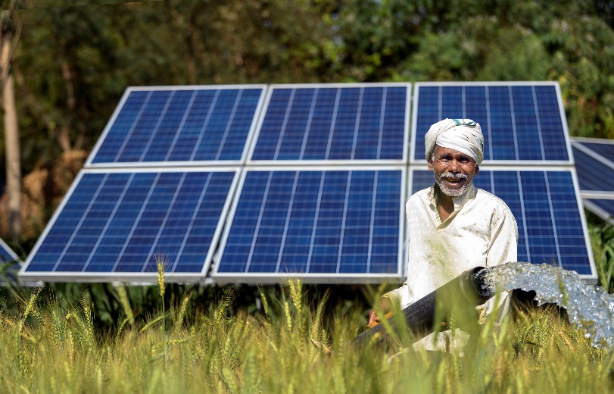
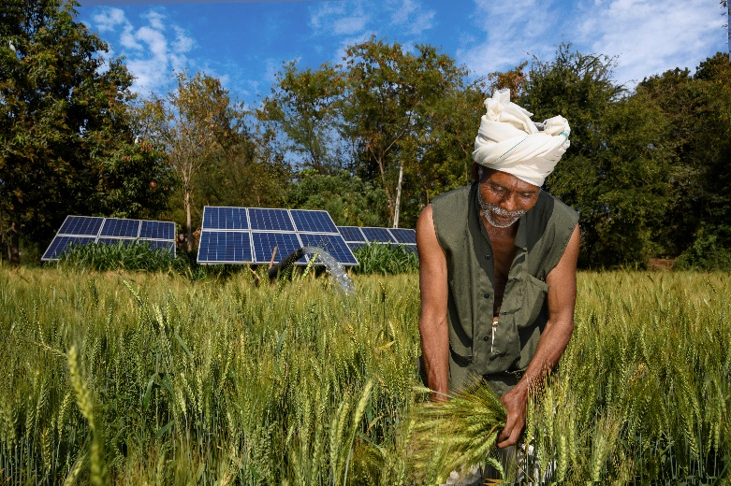
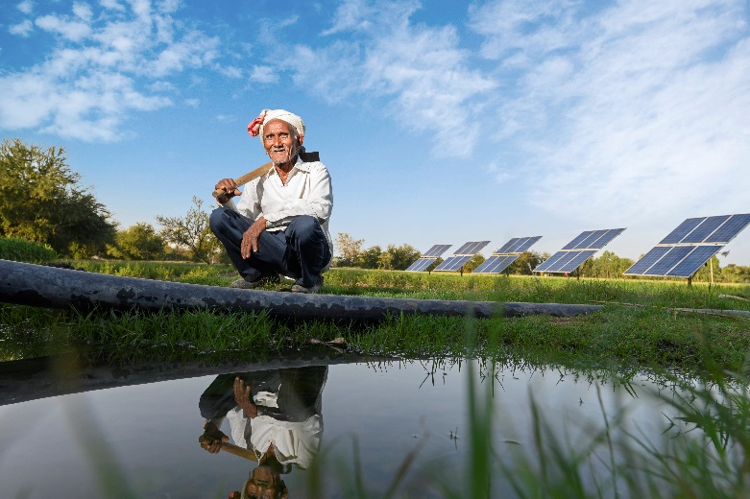





Solar Irrigation Pump (SIP)
Sizing Tool
.
.
Beta Version
| Fourth National Workshop on PM-KUSUM |
| India Habitat Centre, New Delhi | 22nd April, 2022 |
Shilp Verma
Senior Researcher, IWMI

Slide 2
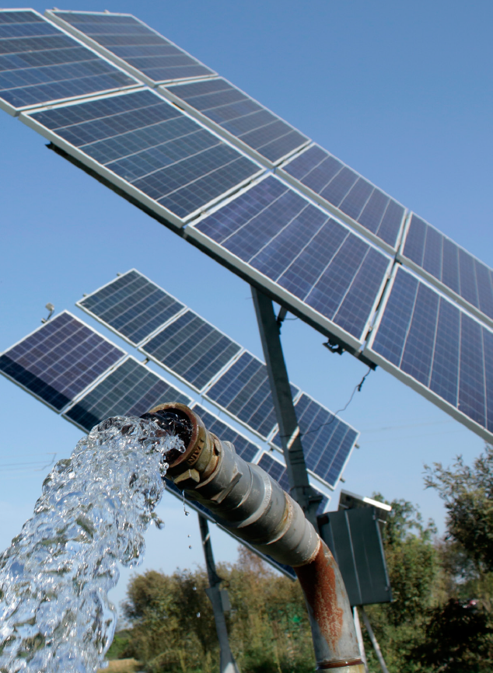
Right Sizing Solar Pumps
PM-KUSUM: World’s largest ‘agri-solarization’ campaign
  2m standalone and 1.5m grid-connected SIPs are envisaged
  These would entail significant public and private investments
  Optimal sizing required to ensure full utilization and to avoid maladaptation
Proper design of an irrigation system requires that the pumping system be precisely matched to meet irrigation requirements
Negligent under-sizing and/or unnecessary over-sizing can be avoided with a simple but robust DSS
  The SIP sizing tool (Beta version) is designed to provide guidance for key stakeholders including farmers, SNA officials, bankers, field practitioners and solar developers

Slide 3

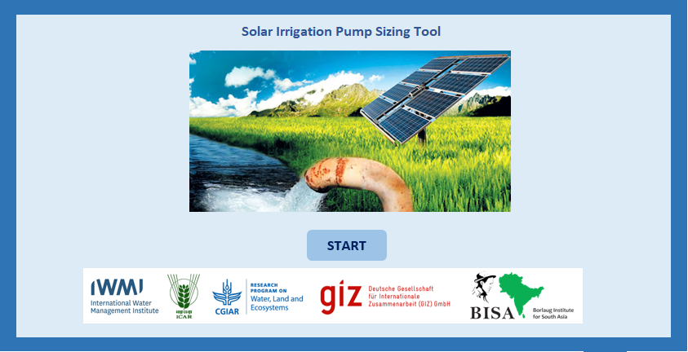
Key Features…
Built in MS Excel for easy inter-operability
Fully functional in ‘offline’ mode
Most user inputs pre-loaded using secondary data
User free to over-ride default options
Suitable for data-poor as well as data-rich environments

Slide 4
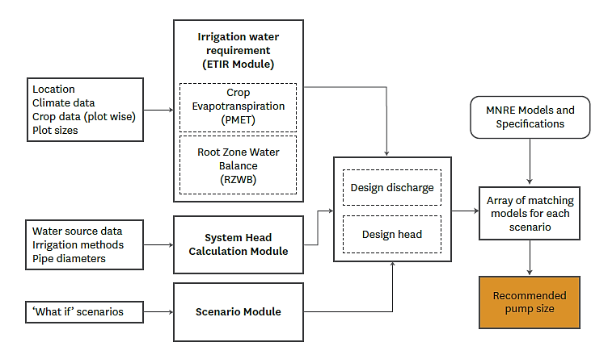
Sizing Tool (Beta version) Architecture…
1
2
3

Slide 5
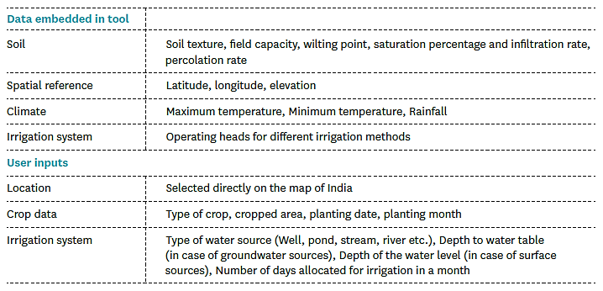
Data Requirements…

Slide 6
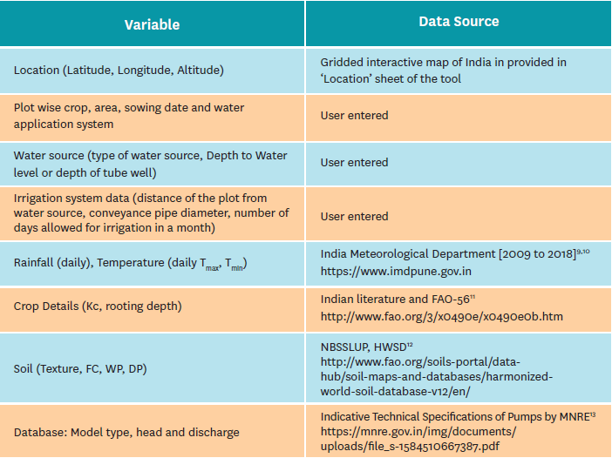
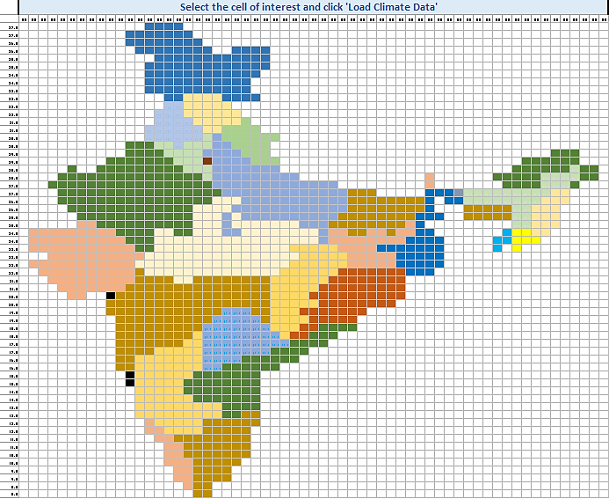
Sources of Embedded Data…
0.5º X 0.5º | ~55km X 55km | 1,204 grids

Slide 7




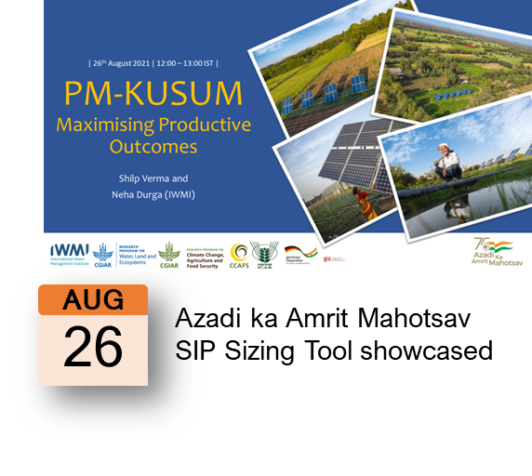

Key Milestones…

Slide 8
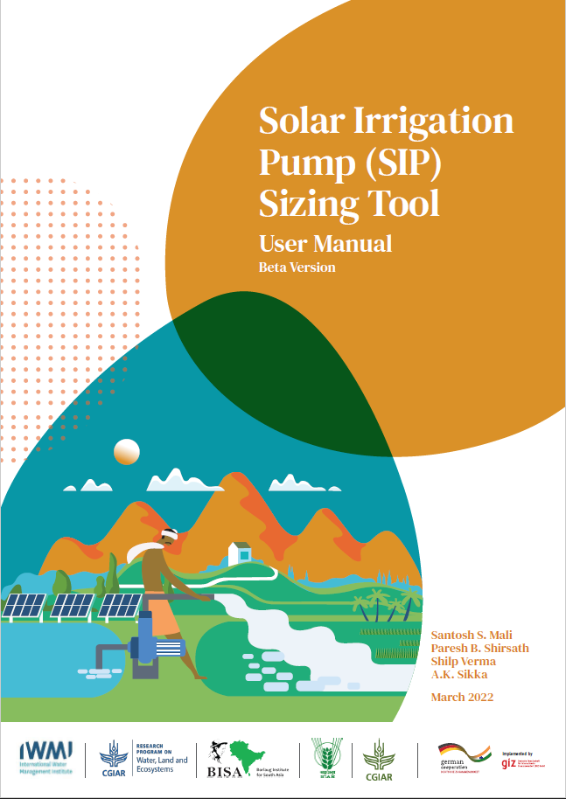
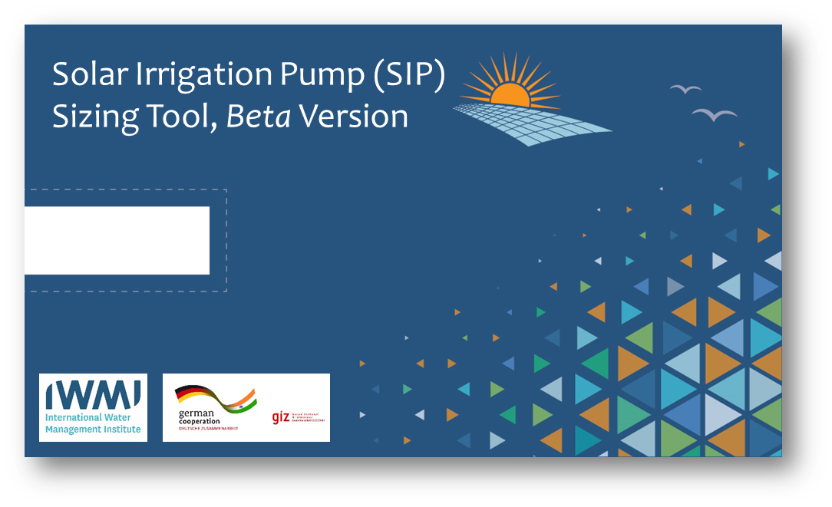
User Manual – Beta Version
Context
Architecture and design
Data and sources
Embedded equations, assumptions
  Irrigation requirement
  Discharge and head
  Pump selection
  Scenarios
Step-by-step guide
Using the tool
Tool + Manual on USB

Slide 9
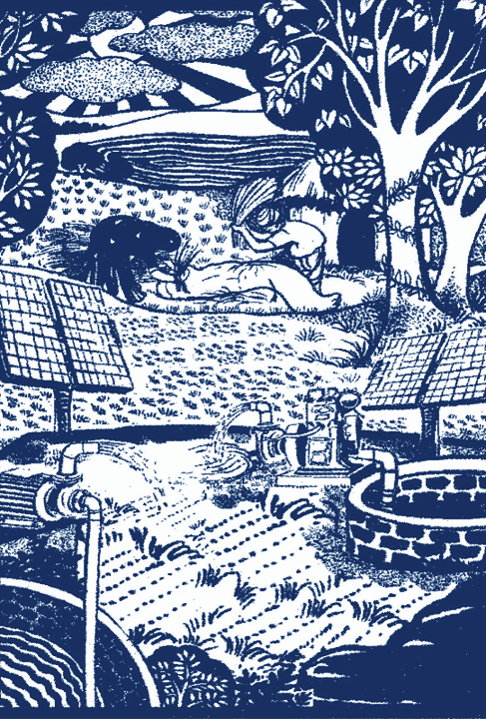
Next Steps…
IWMI will provide User Manual to MNRE for wider circulation among PM-KUSUM SNAs
IWMI and ICAR committed to supporting further development and use of the SIP Sizing Tool
…support MNRE, GIZ and HKRP in development of Mobile Application
…support development of future versions of the tool based on user experience and feedback
Demand for similar tools from other countries…

Slide 10
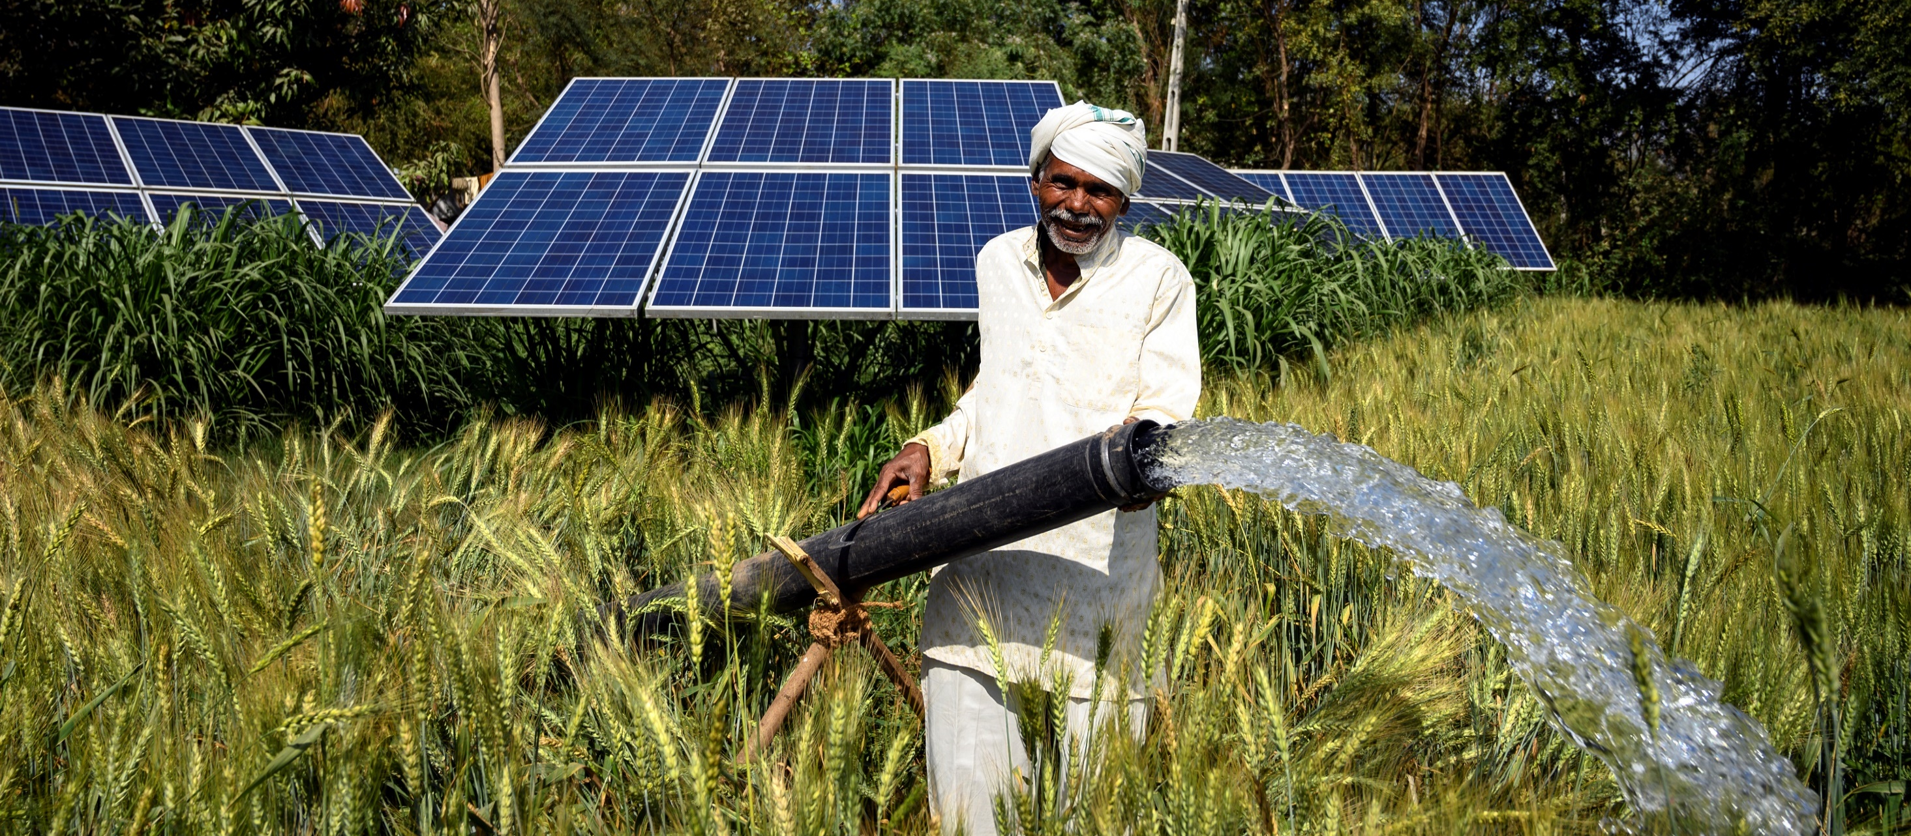


Thank You…

Slide 12
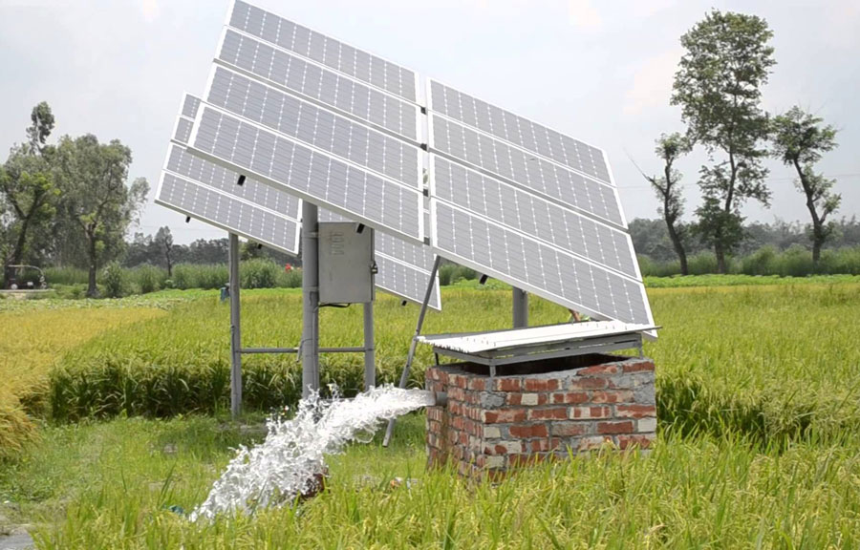
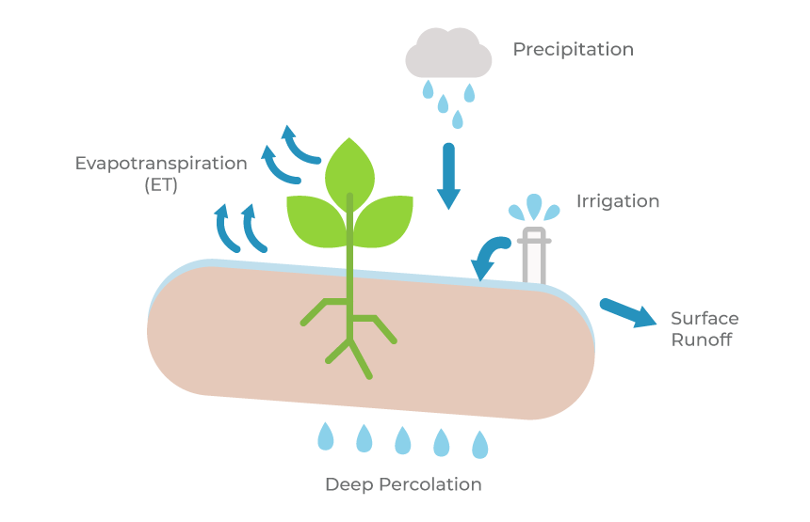


Pump discharge
Pump discharge depends on Irrigation water requirement
Irrigation water requirement
  Number of plots and extent of irrigated area
  Type of crop and sowing dates
  Climate of the area: Rainfall, T_{max}, T_{min}, Wind speed, RH
  Depth of root zone
  Soil type: Field Capacity, Wilting point, Deep percolation rate
  Irrigation system used in each plot
Complex process of Atmosphere, plant and soil interaction
  Data intensive and requires technical expertise
SIPS Tool
  Penman Monteith method for ET0
  ETo at daily time step

Slide 13
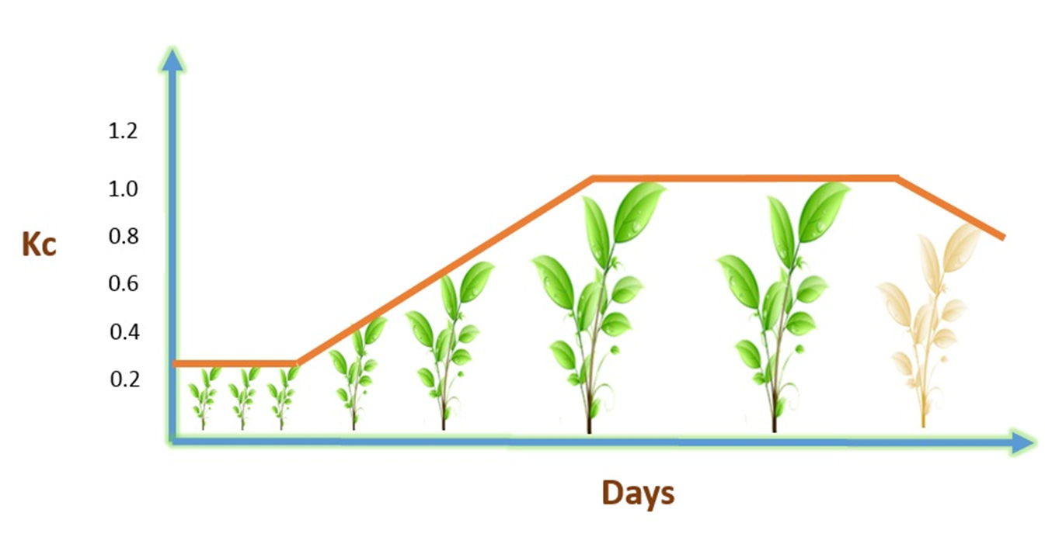
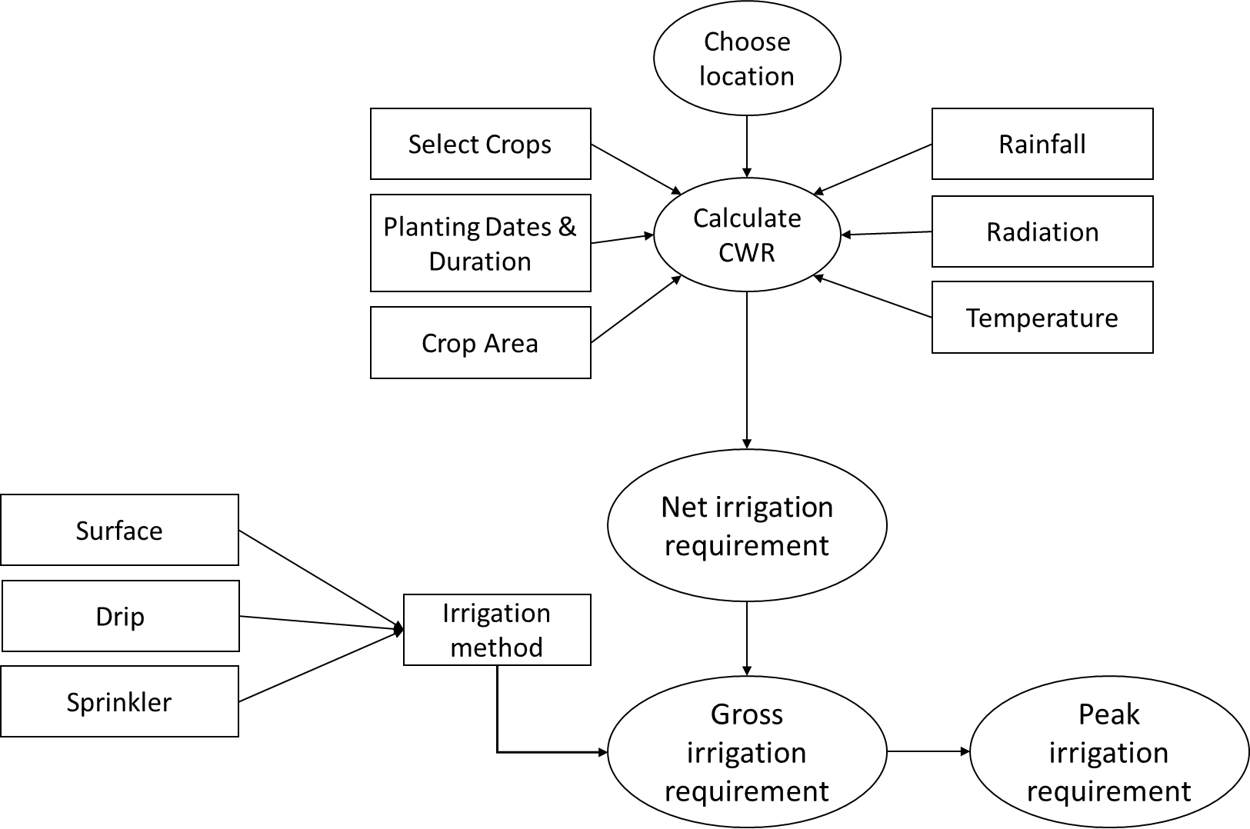
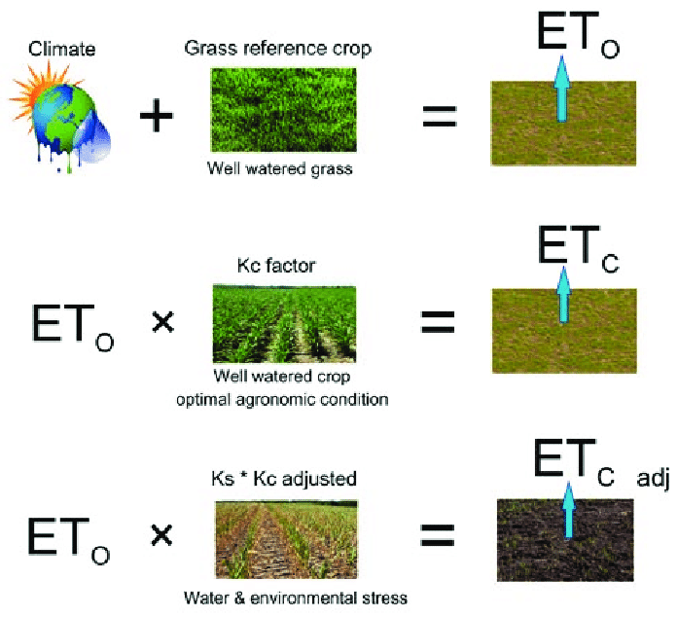
Crop Water Requirement Module
1.1
0.7
0.3
FAO 56

Slide 14
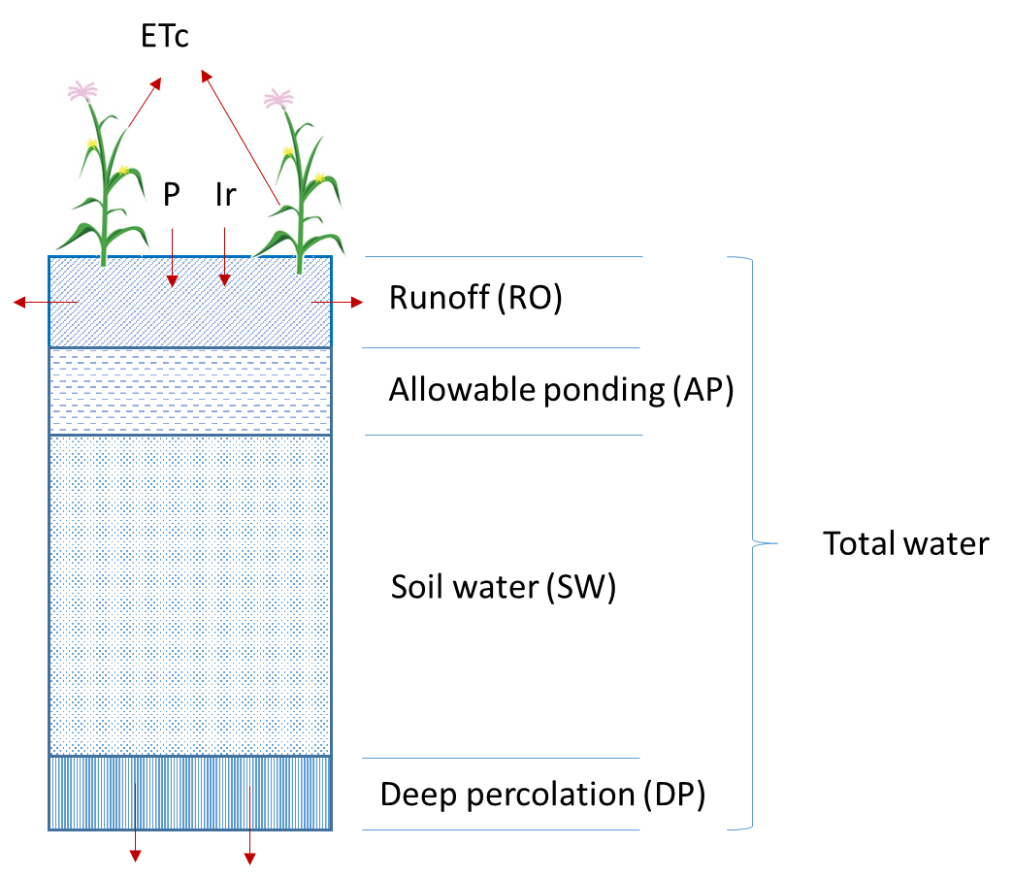
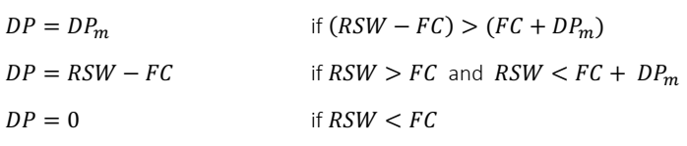
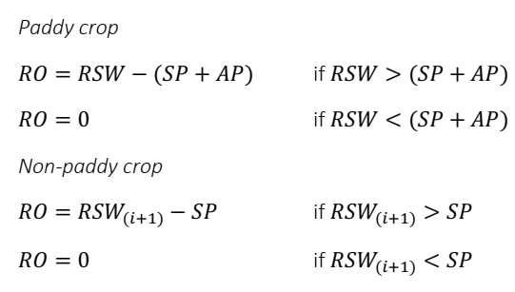


Root Zone water balance
Deep Percolation
Runoff
Water balance on i^{th} Day
$${RSW}_{i}={TW}_{i}−({ETc}_{i}+{RO}_{i}+{DP}_{i})$$
$${TW}_{i}={MC}_{i−1}+\left(P_{i}+I_{ri}\right)$$

Slide 15
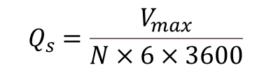
Converting IWR to discharge
Pump should meet discharge needs of all months
Maximum IR of month (V_{max})
Number of days allowed for Irrigation (N)
  Farmers’ Choice
  Available sunny days (>6 hr BSS)
  Type of irrigation system
    Basin/Furrow: 3-6 days
    Drip/micro irrigation: 15-20 days
Pump Q = V_{max}/N
Critical factor: Number of days (select minimum possible numbers for optimal design)
Optimal design depends on parameter ‘N’
$$Q_{s}=\frac{V_{max}}{N×6×3600}$$

Slide 16
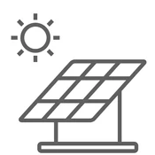
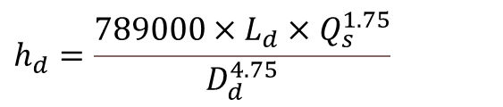

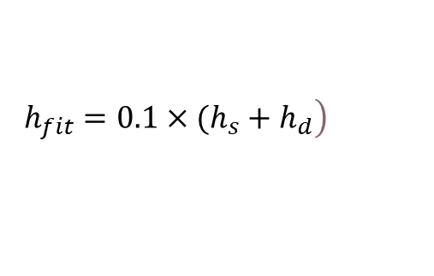
Pump operating head
Operating Head, Ho
Pump operating head (H_{t})
Depth to water level
Depth of tube well
Distance of field from pump (running length)
Pipe diameters (suction and delivery)
Friction losses in pipes
Operating head of the irrigation system
PV array
Field
Control box
Elevation head, He
Friction head, Hf
$$H_{t}=H_{geo}+H_{f}+H_{o}+H_{e}$$
Geodetic head, h_{geo}
Pump
Friction head in pipe: Darcy Weisbach equation
$$h_{d}=\frac{789000×L_{d}×Q_{s}^{1.75}}{D_{d}^{4.75}}$$
Water well
$$\left.h_{fit}=0.1×(h_{s}+h_{d}\right)$$

Slide 17
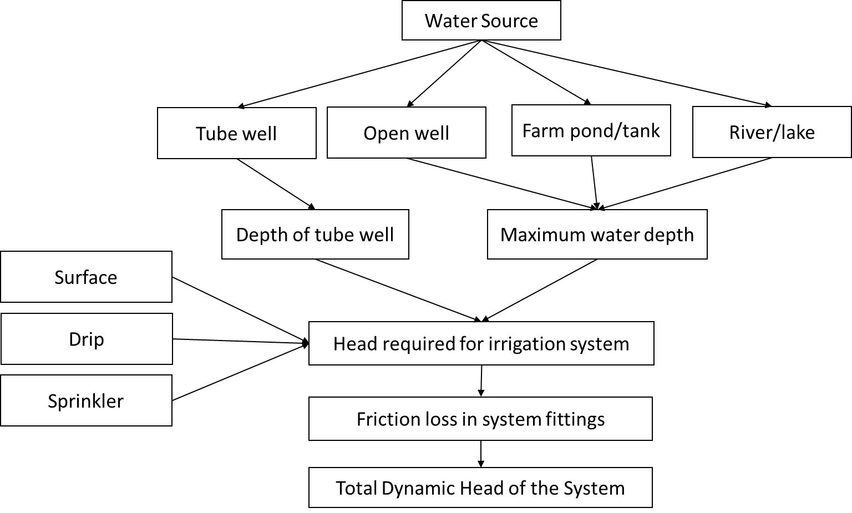
System Head Calculation Module
Irrigation Method | Head required
Surface/flood | 3 meter
Drip or trickle | 14 meter
Micro-sprinklers | 12 meter
Sprinklers | 25 meter
* For surface/flood irrigation systems elevation difference from surface near water source to highest point in the field must be accounted.
Water source | Condition | Geodetic head, m
Stream | WL_{min} <7 m | H_{geo} = WL_{min}
 | WL_{min} >7 m | H_{geo} = 7.0
Open well | d_{ow} <7 m | H_{geo} = d_{ow}
 | d_{ow} >7 m | H_{geo} = 7.0
Pond/lake | d_{p} < 7 m | H_{geo} = d_{p}
 | d_{p} > 7 m | H_{geo} = 7.0
Tube well | Submersible pump | H_{geo} = 0.95 x d_{tw}

Slide 18
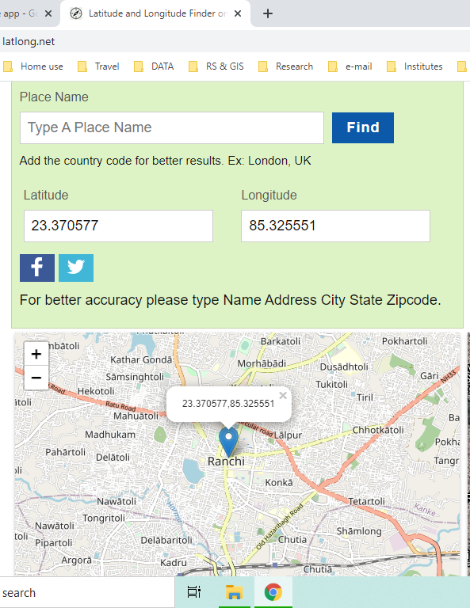

Lat-Long of location
Internet sites
  www.latlong.net
Google earth
  https://earth.google.com/web/
Mobile apps
  Map coordinates
  Latitude Longitude
Tool finds nearest Lat-Long to the accuracy of 0.5º
  81.35689 ~ 81.5
  81.12582 ~ 23.0
Fetches the soil and climate data of the location

