Slide 1

KUSUM Assistance project:
Planning for guidebook on PM-KUSUM component A and component C (feeder-level solarization)
Guidebook for state-level policymakers on PM-KUSUM
Presenter: Siddharth Goel
Date: April 22, 2022
Notes:
CB: It’s not about risk - it’s about transforming business models too, so add language for opportunities too
BV: align with CDEP language

Slide 2





Project consortium

Slide 3

Guidebook on PM-KUSUM
Phase- I
Phase- II
Solar pumps
PM-KUSUM Components B & C(IPS)
Solar feeders
PM-KUSUM Components A & C (FLS)
Under development
https://www.iisd.org/system/files/2021-12/implementing-solar-irrigation-sustainably.pdf

Slide 4
Project aims and activities
Key Objectives
Create a best-practice guidebook with recommendations to support state agencies in sustainably implementing the PM-KUSUM scheme
Provide technical assistance to states in overcoming bottlenecks associated with PM-KUSUM component A and component C (feeder-level solarization)
Develop case studies to capture learnings from schemes and projects relevant to the PM-KUSUM scheme
Activities
  Stakeholder consultations with state, central government officials and policy experts
  Review of existing literature and data
  Case studies on existing schemes and projects
  Background paper on Agrivoltaics

Slide 5
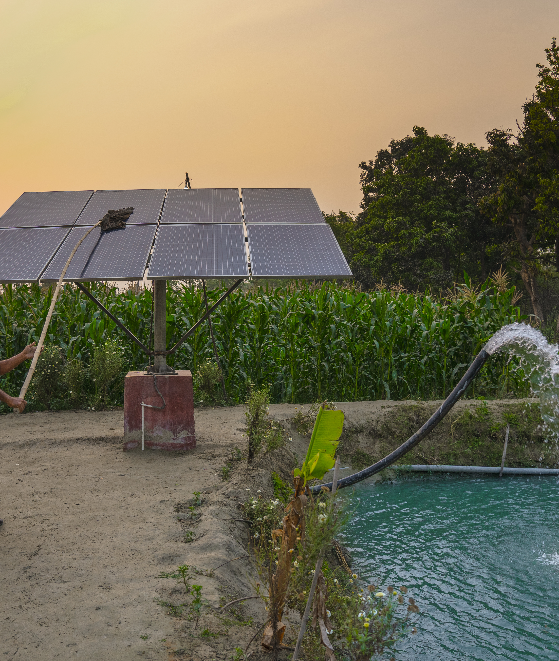




Guidebook for PM-KUSUM A and C
What is the scheme all about?
Context
How can states ensure the sustainable financing of the scheme?
Financing
How can states design and implement a scalable and sustainable model?
Coordination and scheme design
How can states maximise learnings from their initial projects?
Innovative approaches: Learning by doing

Slide 6

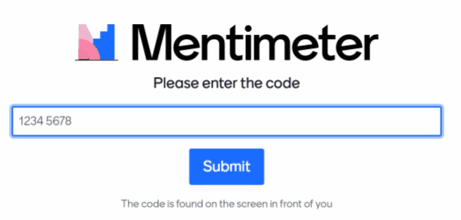

Online poll
Step 1
Open your web browser
Step 3
Use this code 48276846
Step 2
Go to www.menti.com

Slide 7
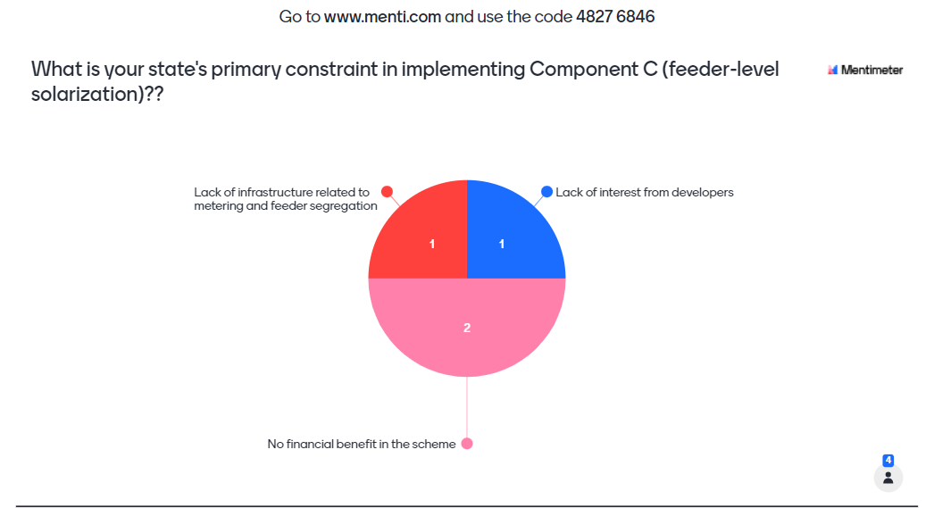

Slide 8
Proactive measures will address developers’ concern
Guarantee through ‘deemed generation’ clause
Feeder strengthening through RDSS
Low grid availability
Priority clearance of bills
Enforcement of Letter of Credit (LC) mechanism
Delay in payment
Creating land banks
Use of GIS to identify the lands
Difficulty in finding land
Proper benchmarking of costs
Consideration of additional logistical and operational costs
Unviable tariff

Slide 9
States can benefit from the model in multiple ways
For every unit bought from a Component – A power plant, a discom in Karnataka saves INR 0.54 over 25 years. The savings from Component-C is much higher due to 30% CFA
PBI
REC purchase
Transmission charges
Tariff payment
Fixed cost
Additional benefits
Generation of local employment
Improved quality of power and power factor at the 11 kV level
Better load balancing
Variable cost
This analysis is for Component–A for a discom in Karnataka based data from tariff orders.
Source: CEEW

Slide 10
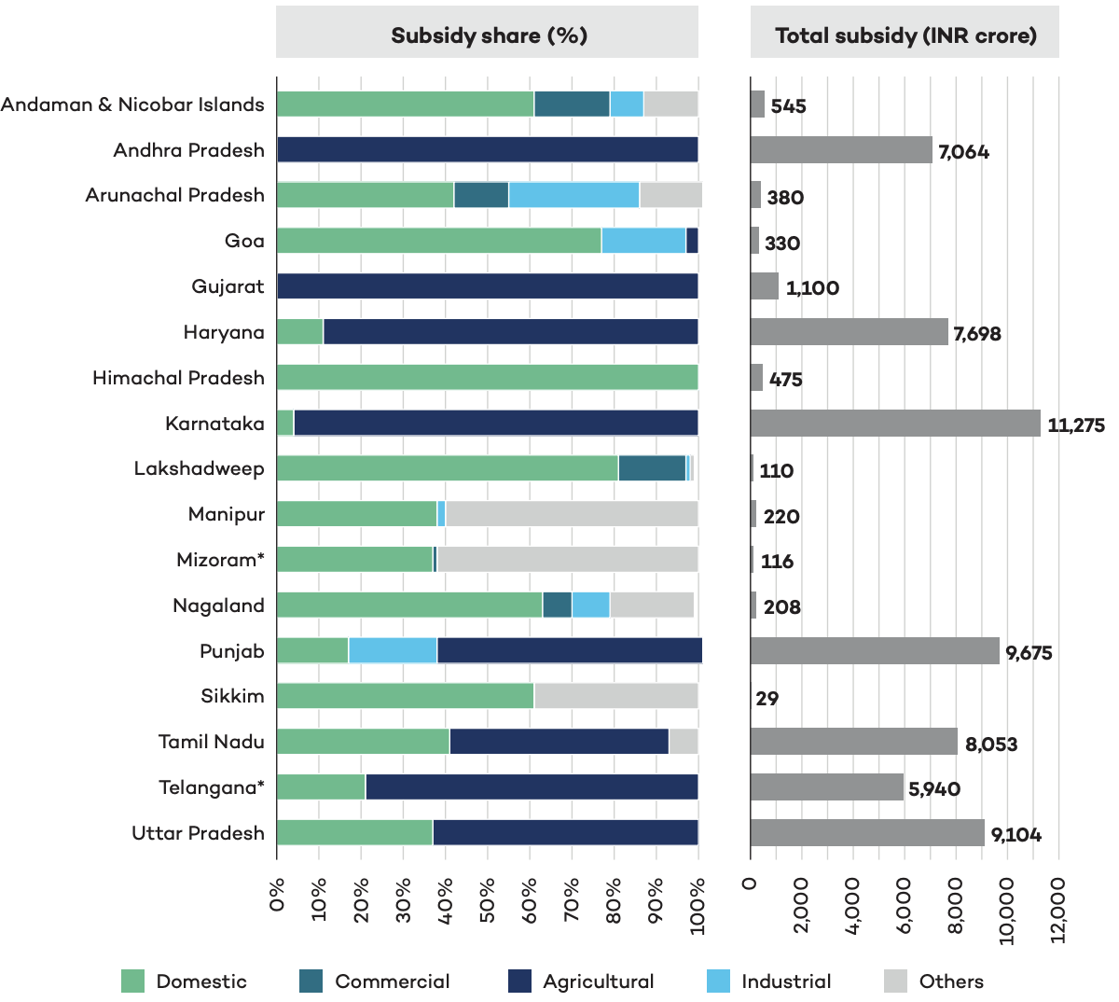
PM-KUSUM can be an effective tool to target subsidies
Share (%) of total electricity subsidies received by different wealth quintiles
Source: https://www.ceew.in/publications/unpacking-indias-electricity-subsidies
Source: Upcoming IISD paper on subsidy targeting in Haryana

Slide 11

Thank You!
Contact: sgoel@iisd.org

