Slide 1
FEEDER SEGREGATION
OBJECTIVE, CONVETIONAL METHOD, CHALLENGES

Slide 2
Objective of Agriculture Feeder Segregation
Currently on a single feeder multiple types of consumers are connected mainly residential, commercial, industrial and agriculture
Round the clock power supply is required for all metered consumers i.e. residential, commercial and industrial consumers
Agriculture supply is subsidized as well as non-metered. So to prevent misuse of subsidized and non-metered energy, it is essential to
limit duration of supply for agriculture consumers to 8-12 Hours instead of round the clock supply

Slide 3



Sub Station
11KV Bus
Existing Power Distribution System at Feeder Level
Feeder Line Length – 10 to 15 Km
Ag Consumers : 100-150,
Ag DT : 40-50,
Ag Load : 0.5-0.7 MVA
11 kV Feeder
1 to 1.5 MVA
11KV
Distribution line
1
2
3
63KVA
4
5
100KVA
63KVA
16KVA
63KVA
11KV
11KV
11KV
11KV
11KV
OG1
OG2
Residential
& Commercial
Service
To
Other Location
433V
433V
433V
433V
433V
M1
M2
Mn
M1
M1
M1
M1
Commercial
& Industrial
Service
Pump (5hp)
Pump (10hp)
Pump (5hp)
M1
M2
Mn
M2
M2
M3
Pump (7.5hp)
M3
Pump (7.5hp)
M1
Pump (10hp)
M4
Pump (10hp)
Pump (3hp)

Slide 4
Sub Station
11KV Bus
Power Distribution System after Feeder Segregation : Conventional Approach
11 kV Feeder
0.5 to 0.7 MVA
Existing Residential, Commercial Consumers
11KV
Distribution line
1
2
3
63KVA
16KVA
63KVA
11KV
11KV
11KV
OG1
OG2
11 kV Ag Feeder
0.5 to 0.7 MVA
To
Other Location
433V
Ag. LVDS
433V
Ag. HVDS
433V
Ag. LVDS
M1
M1
M1
M2
Pump (5hp)
Pump (10hp)
Pump (5hp)
M2
M3
Pump (7.5hp)
M3
Pump (7.5hp)
Pump (10hp)
M4
Pump (10hp)
Pump (3hp)

Slide 5
Challenges and Issues in Physical Feeder Segregation
Costly : Capital Cost of Rs. 0.5-2 Crore Per Feeder
(Budget Considered by MoP as a part of RDSS)
Time Consuming : Long and Lengthy process to lay down a complete new line
Complex : RoW issues makes it complex to implement

Slide 6
IoT BASED VIRTUAL FEEDER SEGREGATION

Slide 7

Sub Station
11KV Bus
Ag Supply Segregation (IT+OT - IoT based Feeder Segregation) : Smart DT Approach
16KVA
11KV
Smart DT
Single Switching
Single Non Solar Pump
11 kV Feeder
1 to 1.5 MVA
6
433V
Pump (10hp)
11KV Distribution
Line
1
2
3
63KVA
4
5
63KVA
100KVA
63KVA
Smart DT
Single Switching
Multiple
Pumps
16KVA
Smart DT.
Multiple Switching
Pumps
11KV
11KV
11KV
11KV
Smart DT
Single Switching
Single Pump
11KV
Residential &
Commercial
433V
433V
433V
M1
M2
Mn
M1
433V
OG1
OG2
Pump
(7.5hp)
To
Other Location
Commercial
Solar
Pump
(10hp)
M1
M2
Mn
Pump (10hp)
Non Solar
Pump
(7.5 hp)
Pump
(10hp)
M1
Pump
(5hp)
Solar
Pump
(10hp)

Slide 8
Conventional Approach of Ag Feeder Segregation
Smart DT (IT+OT – IOT ) based Approach for Ag Feeder Segregation
Capital Cost : Rs. 40-50 Lac per Feeder
Capital Cost : Rs. 15-20 Lac per Feeder
Time : Erection of new Feeder is Time consuming Activity
Very Fast Implementation
which requires up-gradation of existing transformers only
Complexity : Right of Way (RoW) activity
Up gradation of existing feeder only. RoW activities not required
Operations : Manual Switching Operations
Applicable to entire feeder
Automated Schedule based operation
Flexibility to switch individual Service Connection
Remote Configuration update : Season wise, Crop wise etc.
KUSUM : Possible only if 100% Farmers are Solarized
Distribution Losses : Additional Line Losses
Possible even if partial Farmers are solarized
No Additional Line Losses
Reduction in Commercial Losses due to built in Intelligence
Temporary and Permanent Service disconnection in case of Overload
Applicable for 1 Phase and 3 Phase both modes

Slide 9
IoT BASED VIRTUAL FEEDER SEGREGATION
JVVNL PILOT PROJECT OUTCOMES

Slide 10
Pilot for IoT based Virtual Feeder Segregation : 11 KV Manota Feeder
Feeder Details : 11 KV Feeder: MANOTA
Circle: JPDC : Sub Division: KANOTA : 33/11 KV Substation: NAILA
3 Phase Agriculture DTs: 16 KVA : 12 nos

Slide 11
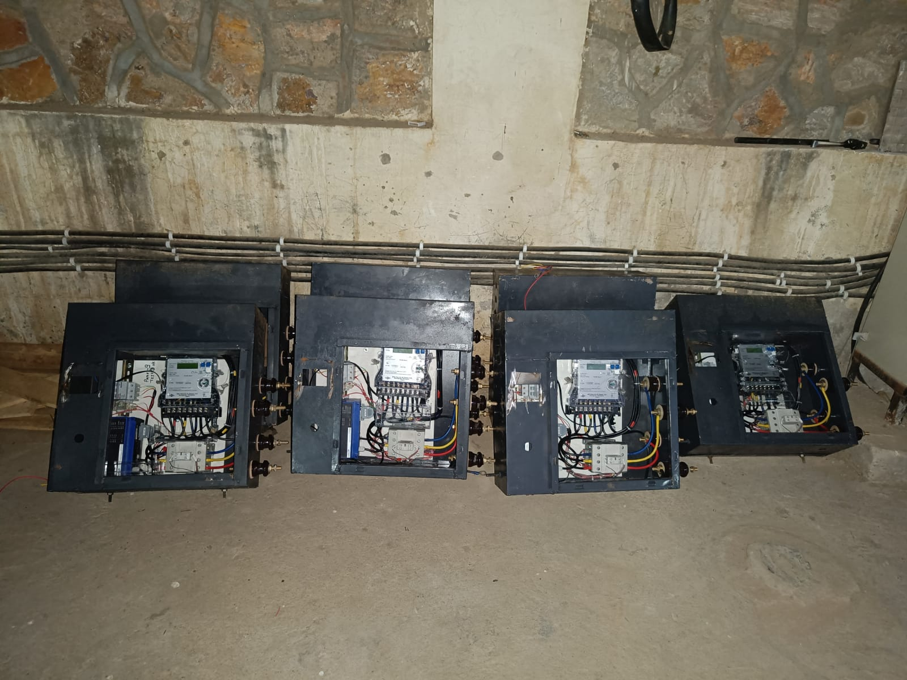
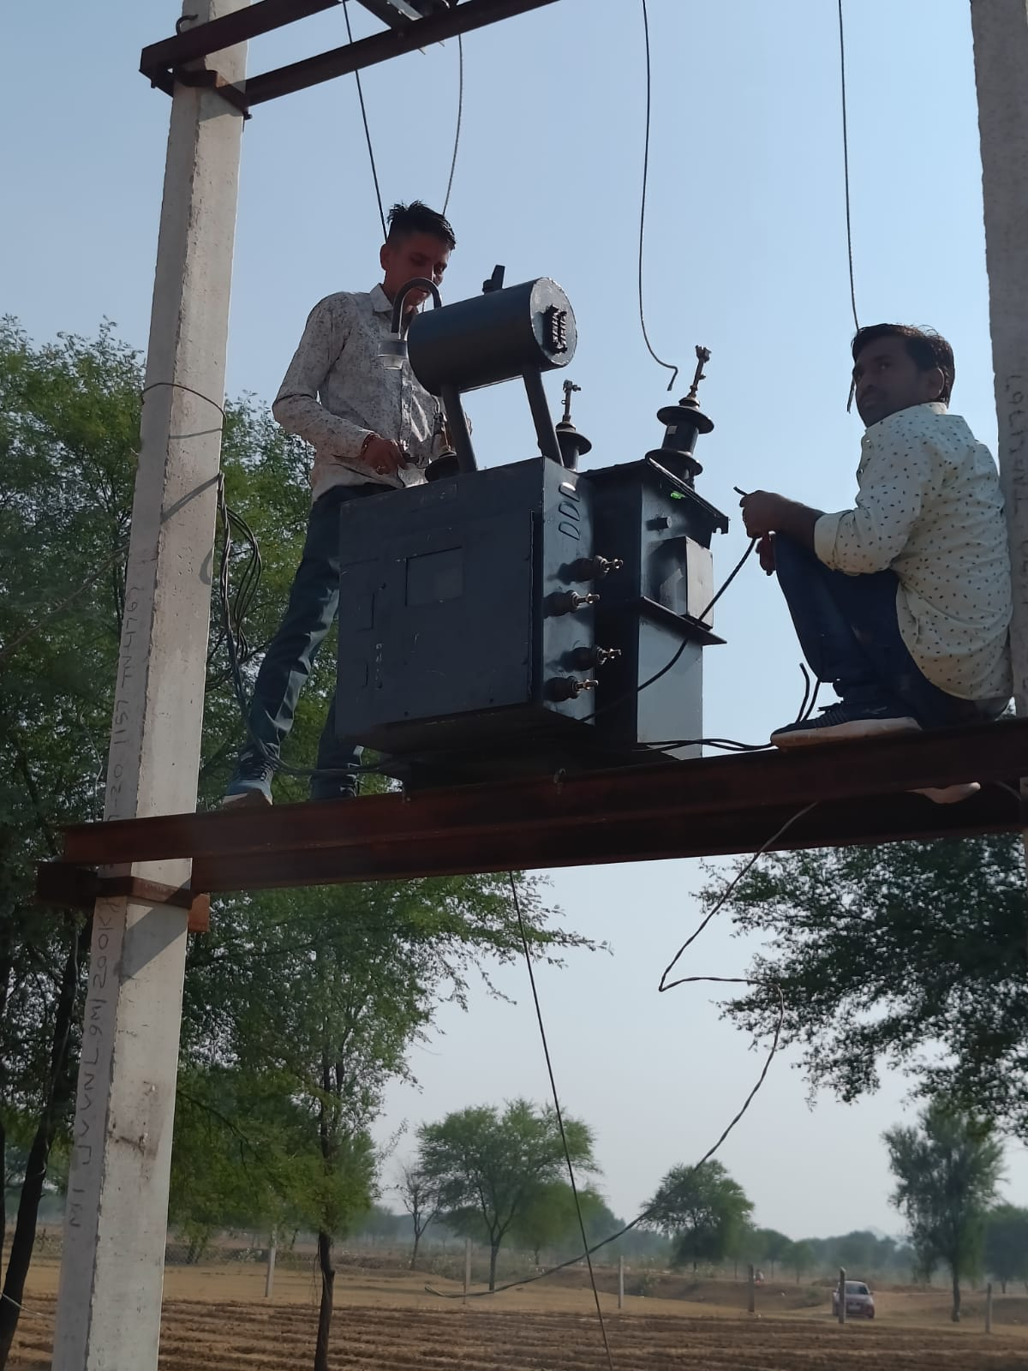
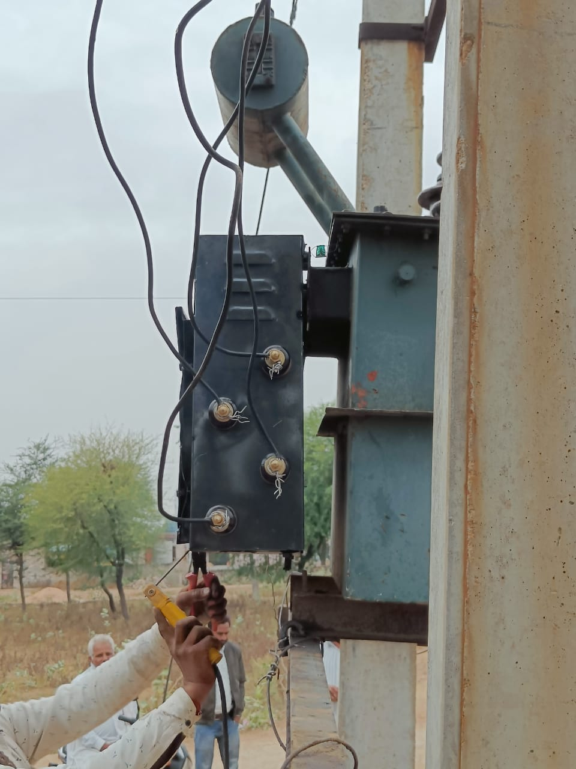
Preparing 12 Sets for 12 AG consumer Transformers

Slide 12
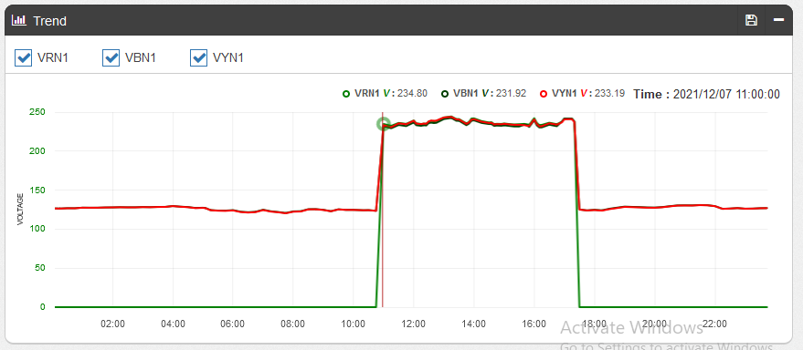
Conventional Feeder Segregation : 3 Phase Voltage for 11 AM – 5 PM

Slide 13
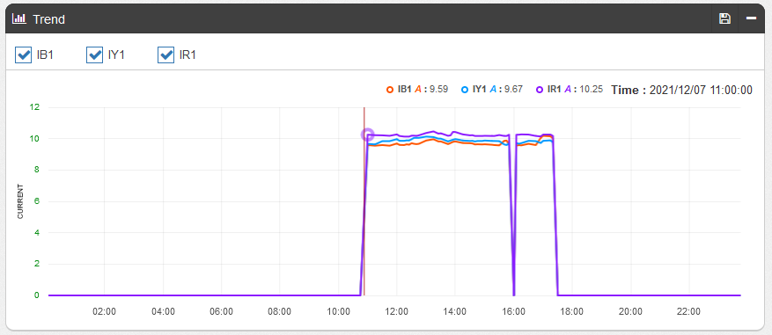
Conventional Feeder Segregation : 3 Phase Load Pattern for 11 AM – 5 PM

Slide 14
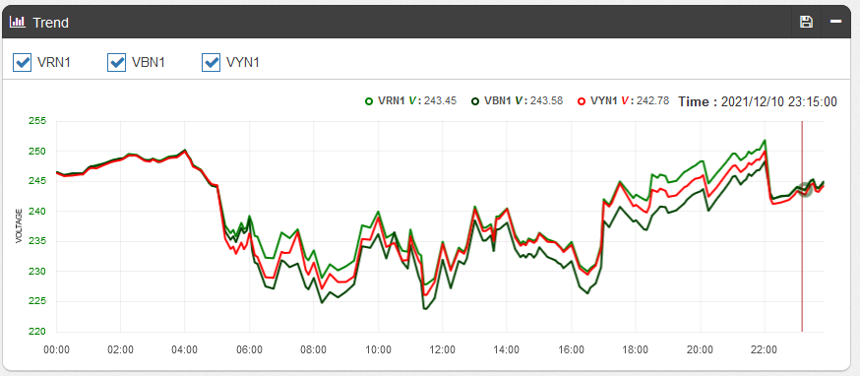
Virtual Feeder Segregation : Voltage Pattern – 3 Phase Voltage for 24 Hours

Slide 15
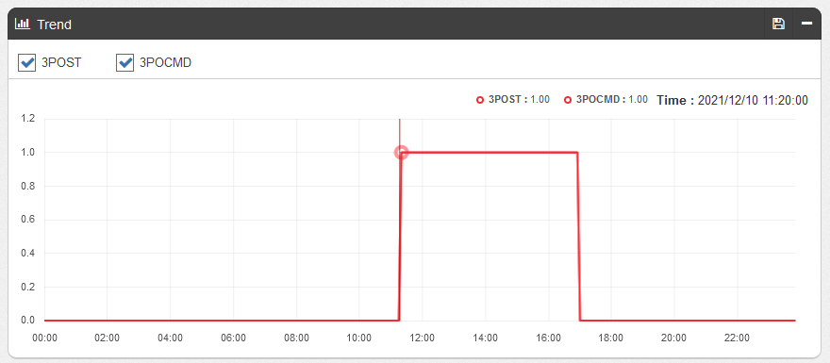
Virtual Feeder Segregation : 3 Phase Switching Command at Transformer Level

Slide 16
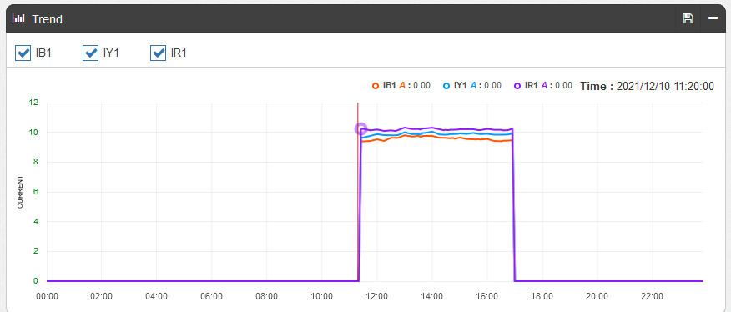
Virtual Feeder Segregation : Load Pattern – 3 Phase Load for 8 Hours Only

Slide 17
Advantages of IoT based Virtual Feeder Segregation

Slide 18
Virtual Feeder Segregation Benefits : Cost Savings
Conventional Feeder Segregation Estimate
Virtual Feeder Segregation
11 kV Overhead Single Phase Line : 4 km. ➔ Rs. 7,66,190
11 kV Overhead Three Phase Line : 7 km. ➔ Rs. 23,76,038
11 kV Feeder Bay Work ➔ Rs. 6,54,429
Single Phase LT Line : 1.5 km. ➔ Rs. 2,77,921
11/0.4 kV Distribution Transformer Work ➔ Rs. 0
Transformer Dismantle & Other Service Charges ➔ Rs. 0
Total Estimated Cost : Rs. 40,74,578
DT AMR, DT Health Monitoring : Additional Rs. 3-4 Lac
Smart Distribution Transformer : 12 Nos.
DT Up gradation Service charges : 12 Nos.
DT AMR & Energy Monitoring Service : 12 Nos.
DT Health Monitoring : 12 Nos.
Annual O&M
- Communication Charges
- Spares
- Software and IT Infrastructure Charges
App. Rs. 5,00,000-600000 for 12 Nos.

Slide 19
Virtual Feeder Segregation Benefits : Time & Complexity Savings
Pre-installation assembling and testing: 2 – 4 Days
Testing with 11 kV Transformer: 2 – 3 Days
Onsite replacement of upgraded Smart Transformers with Commissioning & Go Live
2 – 3 Days for all 12 Transformers of 1 feeder
Total: app. 7-10 Days for a feeder having 10-15 Agriculture Transformers
No Right of Way Issues

Slide 20
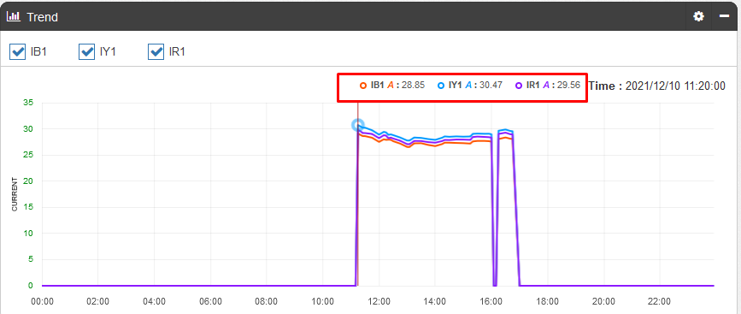
Virtual Feeder Segregation : AMR & Audit – 5 HP Pump – 5 Time Current

Slide 21
Virtual Feeder Segregation : Commercial Loss Reduction
Identification of Load Irregularities:
Consumer | 1 | 2 | 3 | 4 | 5 | 6
Sanction load in HP | 7.5 | 12.5 | 12.5 | 5 | 10 | 7.5
Load Irregularities in HP |  | App. 25 HP | App. 25 HP | App. 20 HP | App. 20 HP
7 | 8 | 9 | 10 | 11 | 12
7.5 | 7.5 | 10 | 5 | 7.5 | 7.5
Built in Protections for Overload to trip with auto re-closure and permanent trip

Slide 22
Virtual Feeder Segregation : Transformer Life
Physical Feeder Segregation : 11 kV HT Side Switching
Virtual Feeder Segregation : No HT Switching
Virtual Feeder Segregation : Identification of Overloading
16 kVA Transformer : Rated Current – 20-22 A
40% Overloaded : Continuous operation at 28-30 A

Slide 23
Virtual Feeder Segregation : Transformer Health Monitoring
Built in High Accuracy Analog Inputs : 0.1% FSR Accuracy
Oil Temperature Monitoring
Oil Level Monitoring
Built in Digital Inputs for Digital Sensor Interface
Sensor for Transformer M&P Box Breakage in case of physical damage
Built in EDGE Computing and Embedded SCADA to Generate Notifications on Abnormality
Correlation and Analytics of Oil Temperature and Over Load Patterns

Slide 24
Virtual Feeder Segregation FAQs

Slide 25
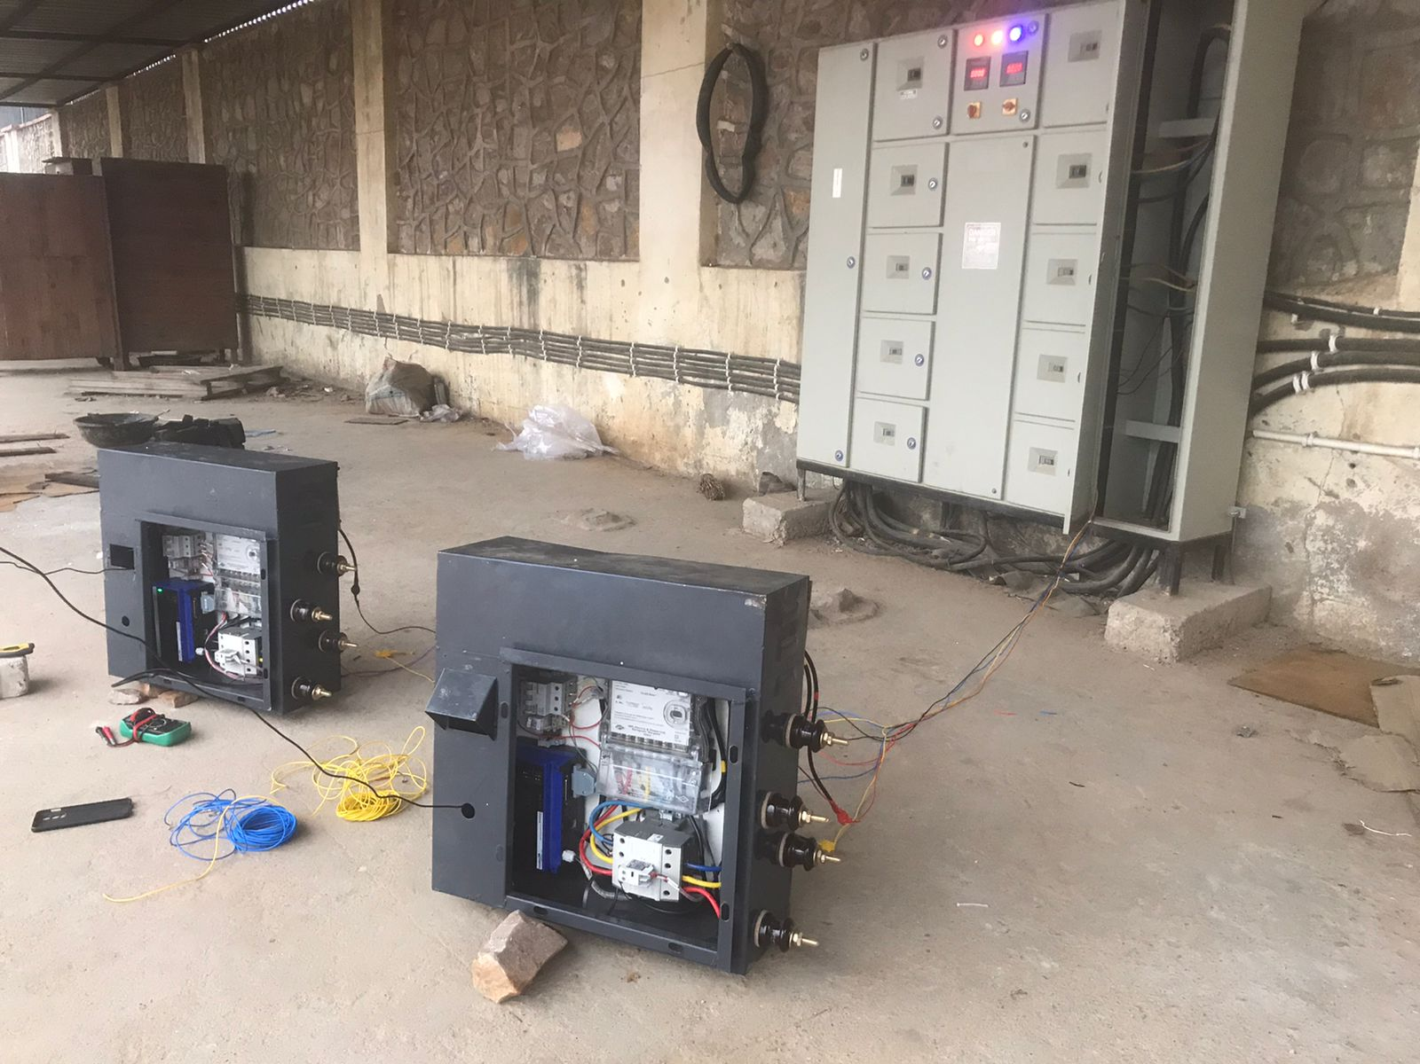
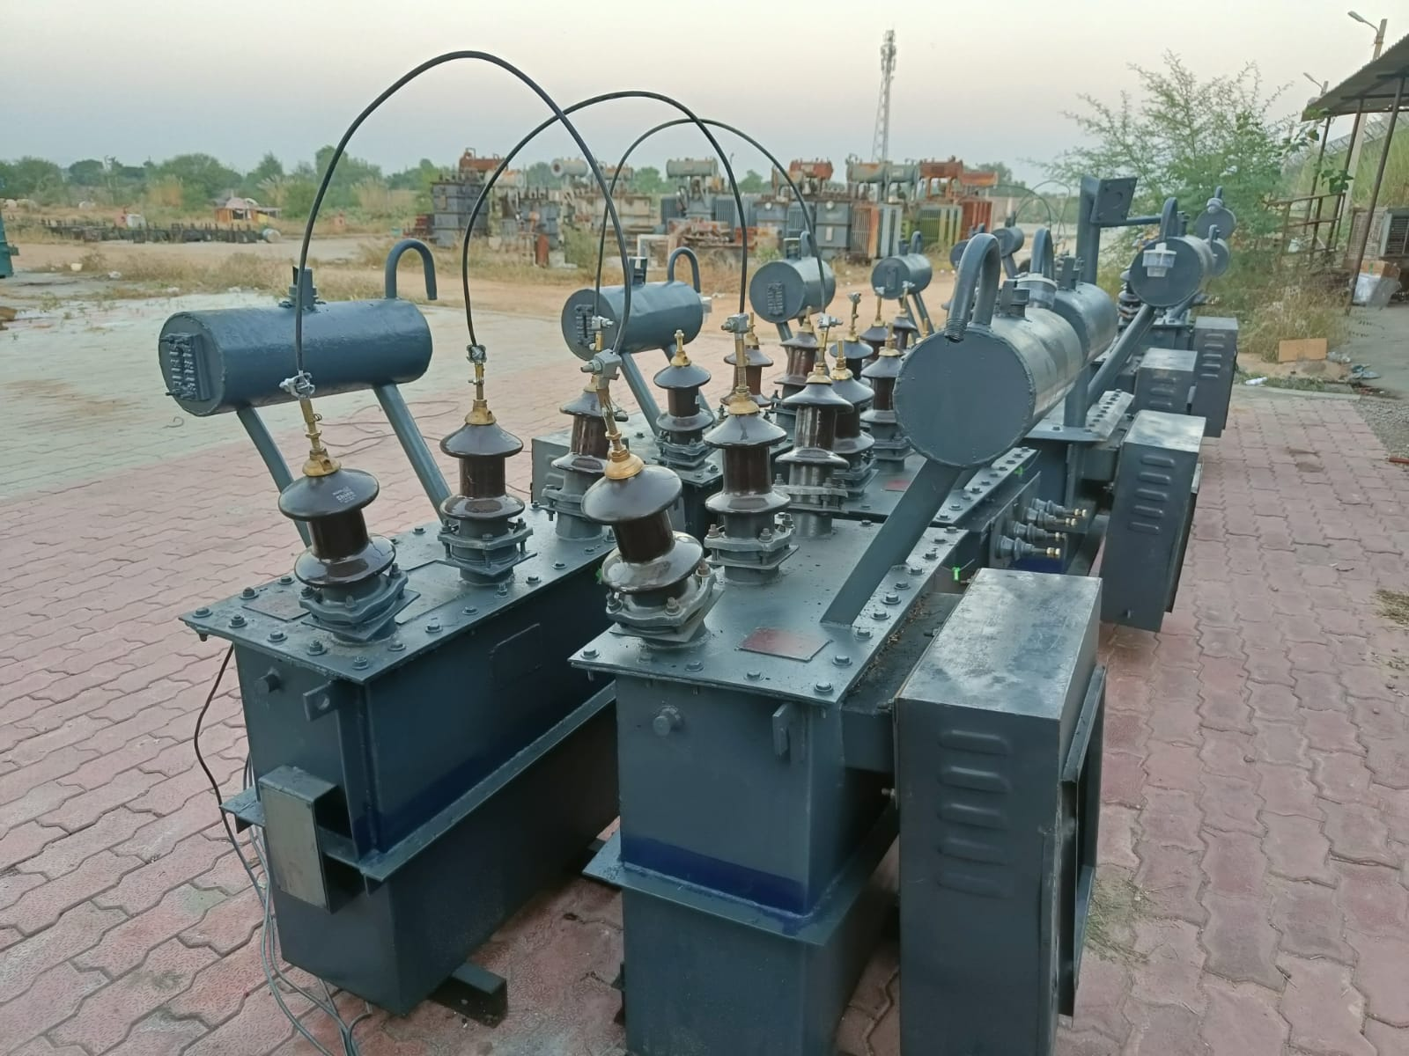
Transformer Size :
HVDS Systems (Single Transformer Single Consumer) : 10 kVA, 16 kVA, 25 kVA,
LVDS Systems (Single Transformer Multiple Consumer) : 63 kVA, 100 kVA, 200 kVA
2. Will it Affect my transformer warranty ?
No technically not. Transformer LT Bushings remains intact. Operation and Control Mechanism is placed after LT Bushing. So it will not affect transformer warranty

Slide 26
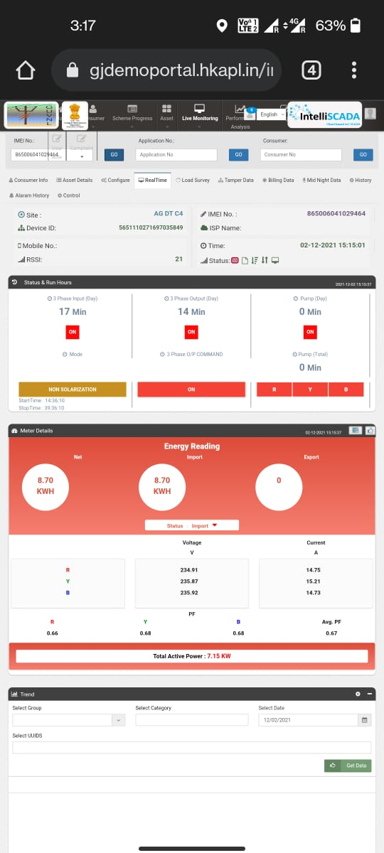
3 How to assemble and install?
It can be assembled on spare transformer of same rating available at Transformer Manufacturing or repairing works along with Testing of transformer supply, operations and communication connectivity. Once assembling and testing is completed, it can be replaced with existing transformer on site as per normal practices

Slide 27
4 What about Transformer Life?
In case of Physical feeder segregation, Daily 2-3 times HT Side switching takes place which affects more as compare to virtual feeder segregation where no HT side switching is taking place. And anyways LT Load Switching and variations will be there due to pump operations.
5 Operations in case of Communication is disconnected:
Device shall store all schedules, operation modes, set point limits and operation logics locally once it is configured to perform operations irrespective of Communication connectivity like RTU or PLC does in the field
6 Transformer Health and Performance?
System is having built in Analog inputs and Sensors for transformer Oil Level and Oil Temperature Monitoring for Transformer Health
It is also having various protections such as overload, over voltage, under voltage, unbalance load, un-balance voltage etc.
7 Is auto re-closure available to avoid site visits of Line Man?
Yes, in case of voltage tripping it will automatically reset once parameter is normal. In case of Overload, configurable frequency and time interval can be set to check and reset the system

Slide 28
8 How flexible are protection logics to avoid false tripping and consumer complains?
Protection Set Points can be configured remotely. Even it is possible enable protection logic and disable trip action against it. This will trigger alarms and notify at server end as well as operator mobile application.
9 What if our schedule changes frequently?
It is possible to update schedule remotely from a central Server without visiting the site. Even multiple farmer level schedules can be configured on a single feeder to manage demand or peak load
10 How secure is the communication ?
Identification : Unique Identification of each embedded client using IMEI Number
Encryption : Entire Communication is encrypted using advance AES 256 algorithm with TLS/SSL Certificate
Authentication : Each Device is having unique Token and Password
Authorization : Access of data is restricted using Authorization policy
OTP : One time password mechanism to operate or update configuration

Slide 29
11 How to maintain connectivity in Remote Agriculture Fields?
Dual SIM with Auto Change Over
MQTT Light weight Protocol with Pub-Sub Mechanism
12 What about Local Connectivity, functionality and it’s security?
In case of non-availability of cellular based remote connectivity, it is possible to update schedule and other set points as well as configuration locally using Wi-Fi connectivity.
Device will act as a wi-fi access point so that smart phone can connect to it without any LAN requirement to update schedule and other configurations.
It shall be password based Access point connectivity which can be changed periodically if required.

Slide 30
How to prevent theft and commercial losses?
13 Protection against LT Theft : What if farmer is operating higher rating pumps on single phase and three phase system?
Overload Protection : Built in Protection to cut off power supply if load is more than configured limits
Phase wise Protection : Even in single phase mode, farmer cannot draw power of more than configured limits
Multiple operation modes : Single phase, three phase, temporary disconnection, permanent disconnection
14 Identification of HT Theft : What if someone is attempting to tap power supply from 11 kV HT Line itself?
Daily basis Energy Accounting and Loss Calculations :
Feeder Sent Out – Sent out of All DTs (Ag as well as Domestic)
If Loss is more than 5% - HT Level Theft notification will be generated

Slide 31
15 Ruggedness : What about physical protection of system from Farmer?
System is an embedded part of Distribution Transformer
3 mm thick metal body welded on Transformer
16 Durability of System : What is the life of this system?
Switching Element (Current Ratings) : Power Contactors - 1.5 - 2 Times of Transformer Rated Load,
AC3 Heavy Duty, IS60947-4 Certified to withstand 8-10 Time Inrush current of Motor Load
Switching Element (Operations) : 1 Million + Electrical Operations, 10 Million + Mechanical Operations
Every day 8 Electrical Operations ➔ 250000 Days, 100 + Years
17 What about Certifications?
Embedded Device: EMI/EMC and Environmental Certificates required for RTU/PLC. With reference to Ministry of Power RT DAS guidelines, it shall have IEC61000-4-2, IEC61000-4-3, IEC61000-4-4, IEC61000-4-5, IEC61000-4-6, IEC61000-4-8, IEC61000-4-11 as well as Cold Heat, Dry Heat, Damped Heat Certificates
Meter: In case of LVDS system where billing is not required, Suitable Type tests and Acceptance test reports are required as per IS14697. In case of HVDS system where billing is to be done by the same meter BIS mark of IS14697 and other state DISCOM specifications are required.

Slide 32
18 What about implementation timeline?
Based on installations in Rajasthan and Gujarat, it is evident to segregate a feeder by replacing transformers in less than 1 Month time after receipt of material
In case of less number of transformer: Rajasthan JVVNL case, 11 kV Manota Feeder, Feeder was segregated within 1 week time after receipt of material at transformer repairing works
19 Is it a monopoly?
No. It is a combination of Embedded Device, Energy Meter and Power Contactors. There are number of manufacturers available for all three components across India

Slide 33
THANKS
HKRP INNOVATIONS LLP

