Slide 1
Asset Condition & Utilization of Solar Water Pumps in India
Results from survey of the solar water pumps in Rajasthan, Uttar Pradesh, Tamil Nadu and Odisha
IGEN-PSWP | Nilanjan Ghose | April 22, 2022

Slide 2
Content of the presentation
Project details and sample overview
Summary of the Survey
Status of asset utilization
Operational conditions;
Break down and aftersales experience
Key takeaways

Slide 3
Solar water pump survey project: Details and status
Project to Ascertain Learnings from State Solar Water Pump Schemes, Focusing on Installed Asset Condition and Implementation Designs being undertaken by KPMG ; Undertaken between Oct 2021 and March 2022.
Survey and audit of 935 solar water pumps installed during 2015-2017 in Rajasthan, Uttar Pradesh, Tamil Nadu and Odisha to:
Analyze operational condition and utilization levels of pumps installed under MNRE’s previous schemes
Understand farmer feedback on application and installation process
Identify gaps and policy solutions
State | District
Rajasthan | Sri Ganganagar, Jaipur
Uttar Pradesh | Pilibhit, Kushinagar
Tamil Nadu | Erode, Namakal, Thirupur
Odisha | Sundargarh, Keonjhar
Key inquiry parameters
Application and service delivery process Operational condition of solar pump Quality of maintenance services Overall satisfaction and usage Impact of solar pumps – cropping patter, irrigation, income

Slide 4
Analysis based on interview of 935 beneficiaries

Slide 5
Status of Assets
Around 86% of 935 surveyed solar pumps being used for irrigation purposes

Slide 6
Survey results summary
Application Process | 52% of the respondents reported that the application approval took more than 3 months. 24% of the respondents reported time lag of two months for installation of pumps (post approval) Only 11% of farmers stated that they were informed about the capacity of pump available during filling up of application form
Operational condition | 35% of inspected SWPs found to be properly maintained; 51% had minor incidences, and 18% major incidences 58% SWPs being cleaned at least once within 2 weeks; 9% on half-yearly to yearly basis; 7% has never been cleaned 92% of installed SWPs in shade free area

Slide 7
Survey results summary
Breakdowns and aftersales experience | 64% of SWPs have experienced some breakdown since installation 13 % of the assets have breakdown up to five times or more) Common components to fail include controller circuit and motor 27% not aware of any number to contact vendor 40% of farmers not satisfied with vendor service – 40% not aware of service centre location; – service centre located beyond 50 kms for 14% farmers – 49% issues resolved in a week; -- 37% in 1-2 month; -- 14% beyond 3 months – 29% paid for repair
Impact on Cropping Intensity and use of alternative pumps | Both gross cropped area (GCA) and net cultivated area (NCA) rose for all the surveyed states post solar pump adoption. Diversification towards horticulture crops post solar adoption is observed for many farmers. Use of diesel pump has reduced across states but not the same for electric pump

Slide 8
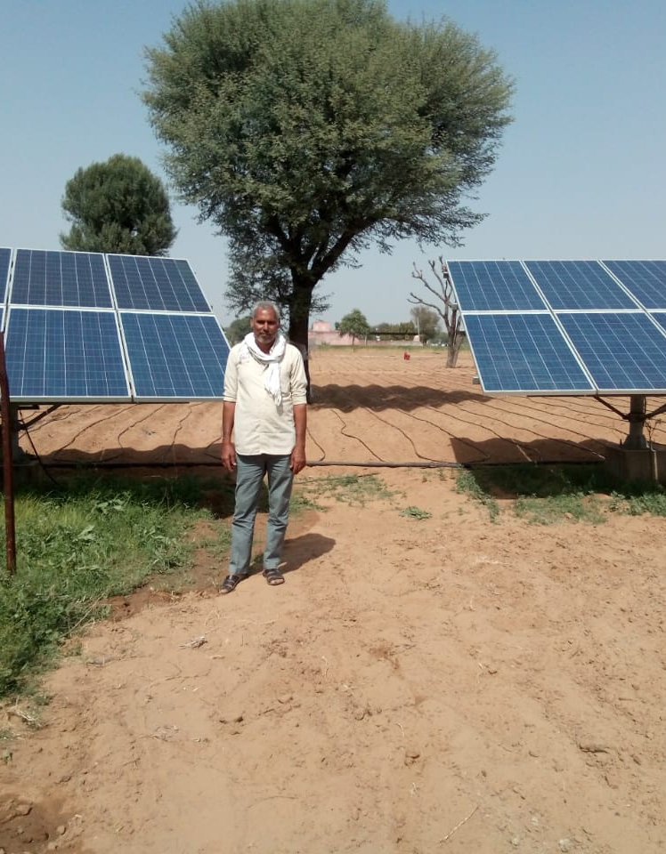
Key takeaways for State Implementing Agencies
Strengthening the Monitoring and Evaluation protocols leading to greater accountability and transparency in terms of the after sales services (Effective use of digitization based rating of the services; levels of responses based on the scale of the problem; common helpline number for states; ability to monitor the response time post a complain has been launched;)
Improved targeting leading to optimal asset utilization (explore the nature of use primary or secondary use; use of decision support tool on sizing of the solar water pumps; site selection tool; rolling out of the Universal Solar pump controllers)
Increased co-ordination with the relevant implementing agencies leading to greater impact (To address the multiple objectives of PM-KUSUM like reaching small and marginal farmers; boost crop productivity; prevent over-exploitation of ground water use) Convergence with state level schemes and other initiatives like Agricultural Infrastructure Fund)

Slide 9
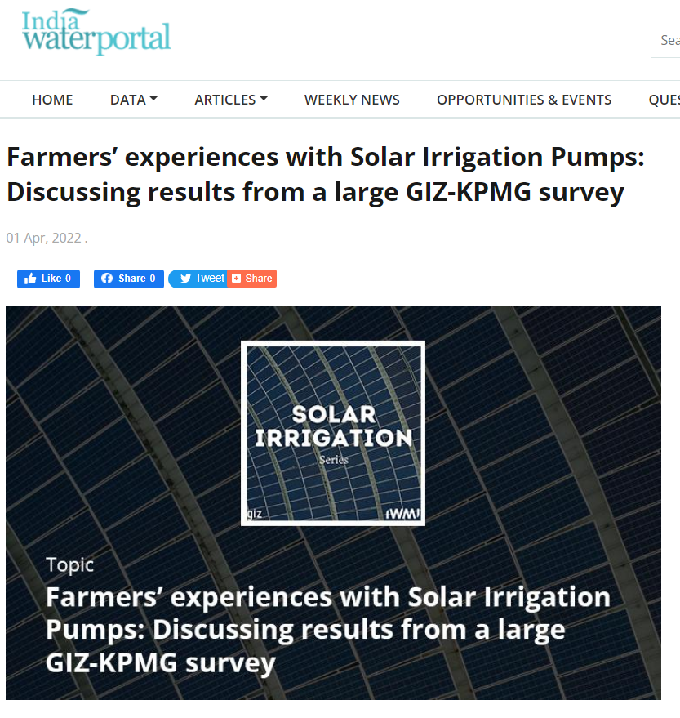
Link to the podcast : Farmers’ experiences with Solar Irrigation Pumps: Discussing results from a large GIZ-KPMG survey | India Water Portal

Slide 10
Thank you.

