Slide 1

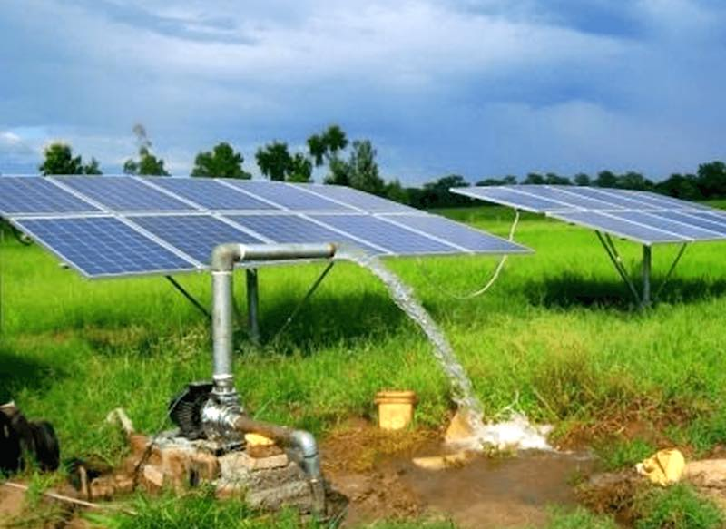
Ministry of New and Renewable Energy (MNRE)
Remote Monitoring under PM-KUSUM
Outcome & Challenges
Fourth National Workshop 22-April-2022

Slide 2
Objective & Outcome of Remote Monitoring System
Objective : To monitor, track and improve Utilization of Deployed Assets
Asset Tracking :
Location and Status of Asset
Asset Usage Analysis
Water discharge
Pump Usage Pattern
Asset Performance Analysis
Energy Generation
Capacity Utilization Factor
Improvement in Quality of Supply & Services

Slide 3
Farmer Details : Shri Pal Singh
Application / Saral No | SWPS/2020/01455
Pump Details | 7.5 HP AC Submersible
Land Coverage Area | 4 Acres
Town | Sultanpur
District | Gurugram
State | Haryana
Installation Date | 20th April 2021

Slide 4
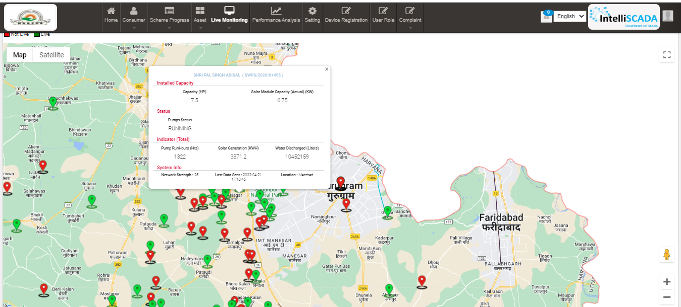
Location & Status Tracking – 21st April, 2022 – 17:10

Slide 5
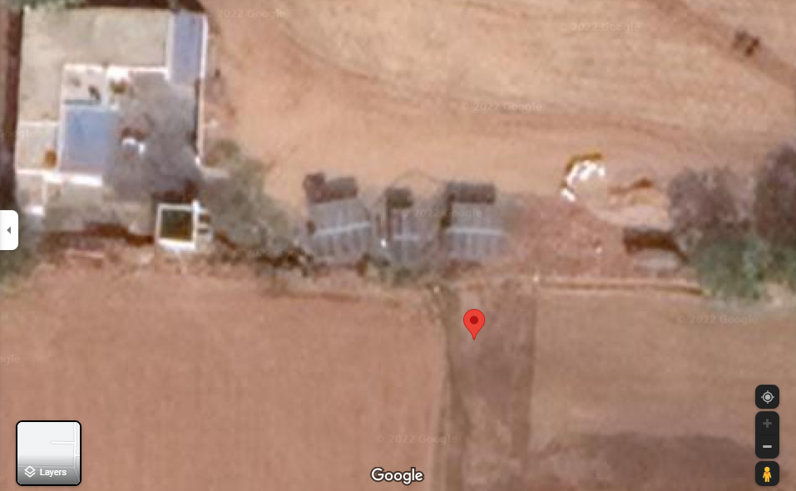
Location Tracking – Satellite view

Slide 6
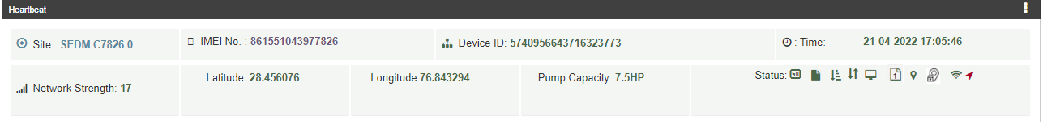
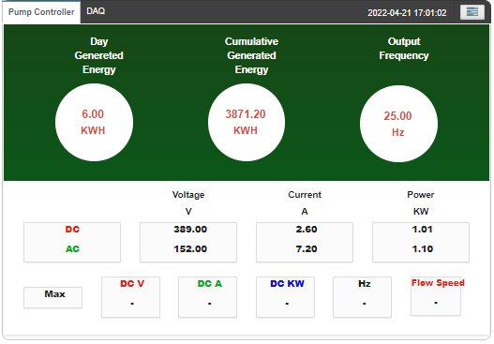
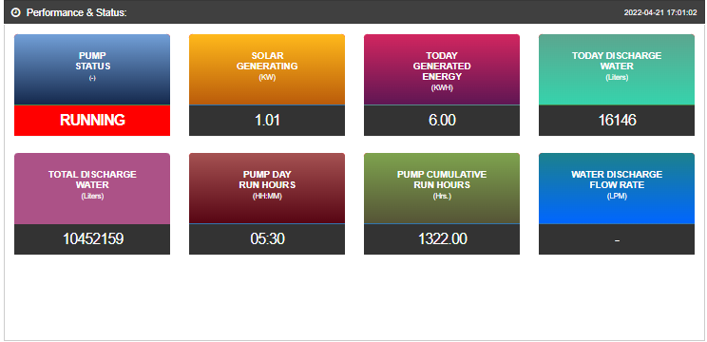
System Monitoring Parameters : 21st April, 2022, 17:01

Slide 7
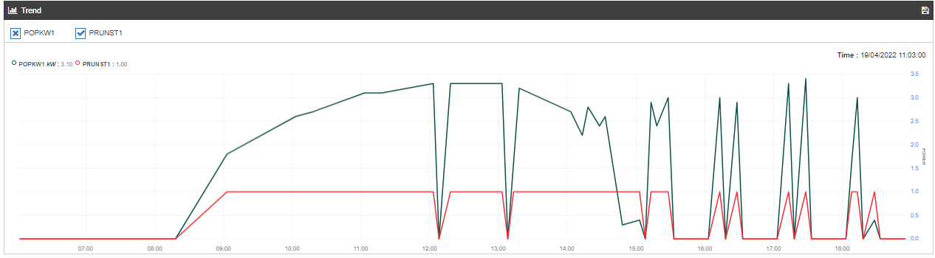
Pump Usage Pattern : 19th April 2022
Power
Generation
Pump Status

Slide 8
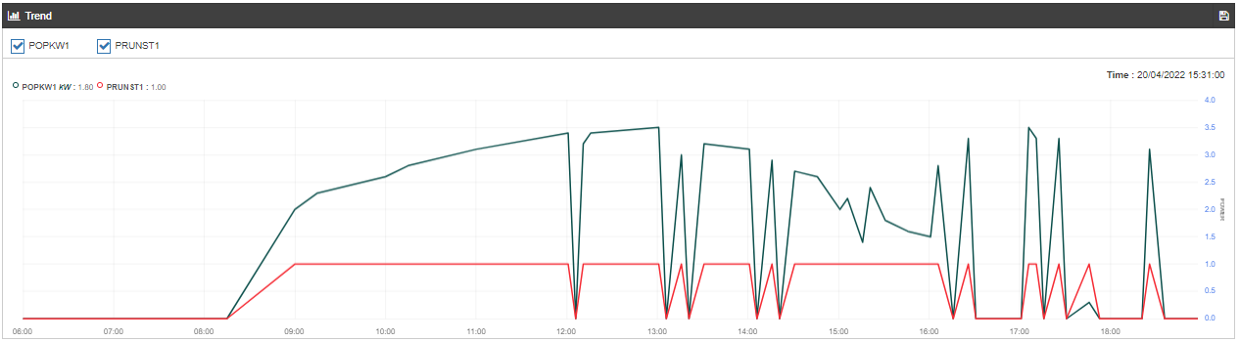
Pump Usage Pattern : 20th April 2022
Power
Generation
Pump Status

Slide 9
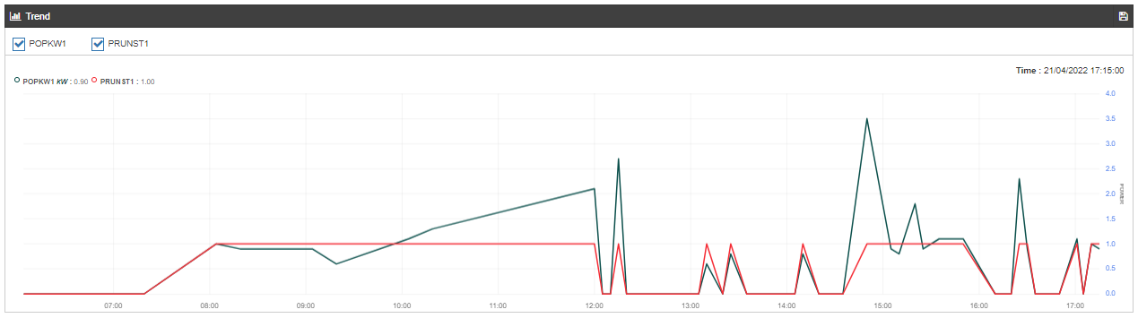
Pump Usage Pattern : 21st April 2022
Power
Generation
Pump Status

Slide 10
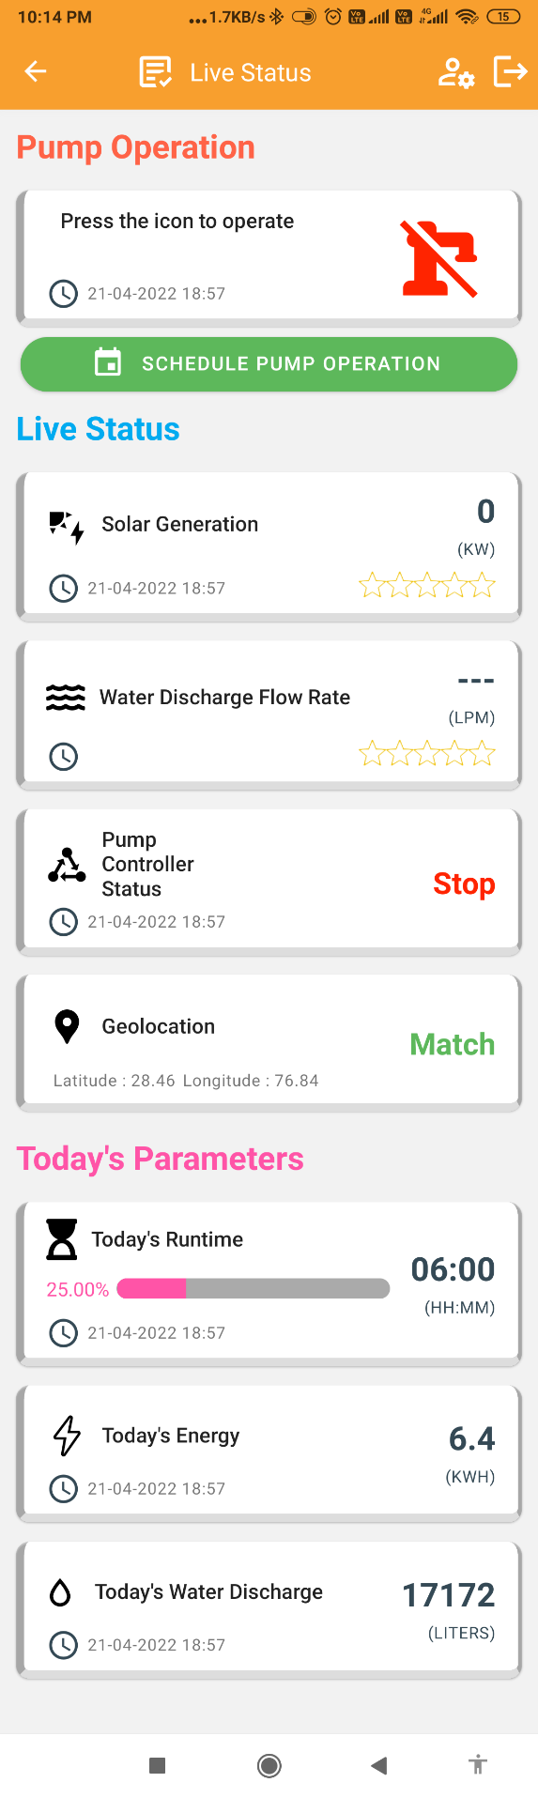
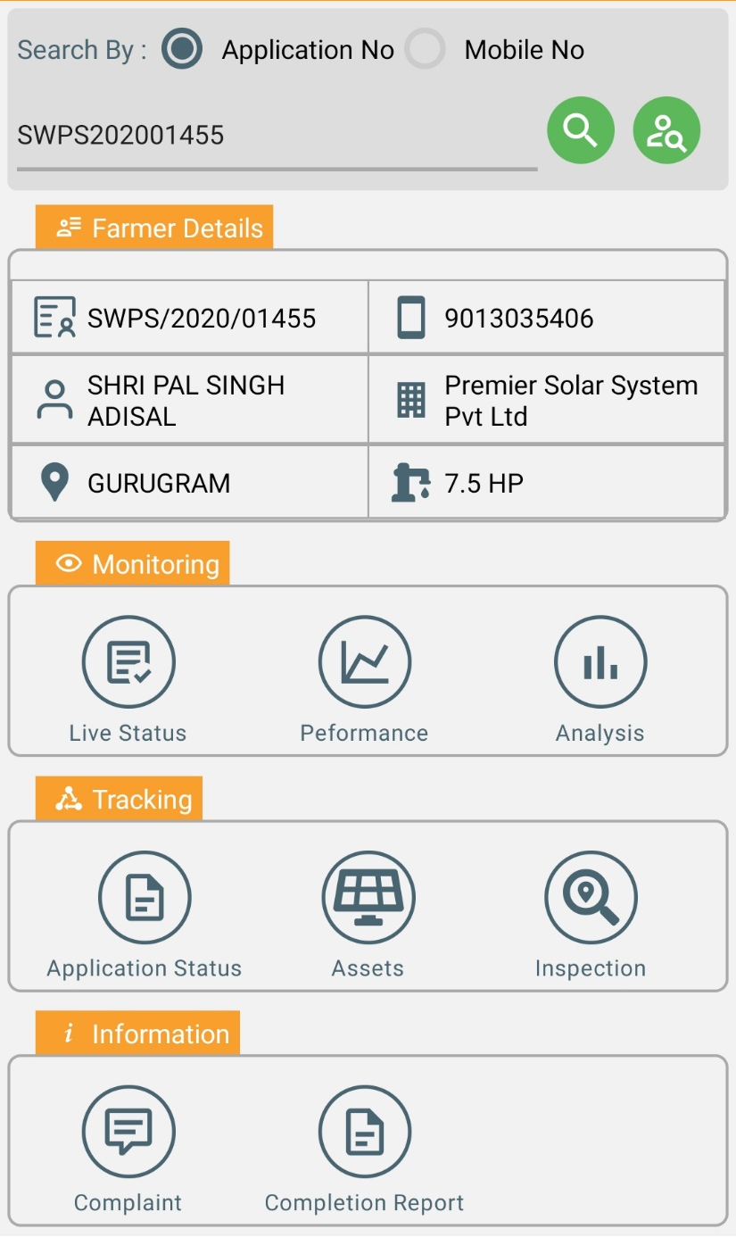
KUSUM Mobile Application – Live status : 21st April, 2022, 18:57

Slide 11
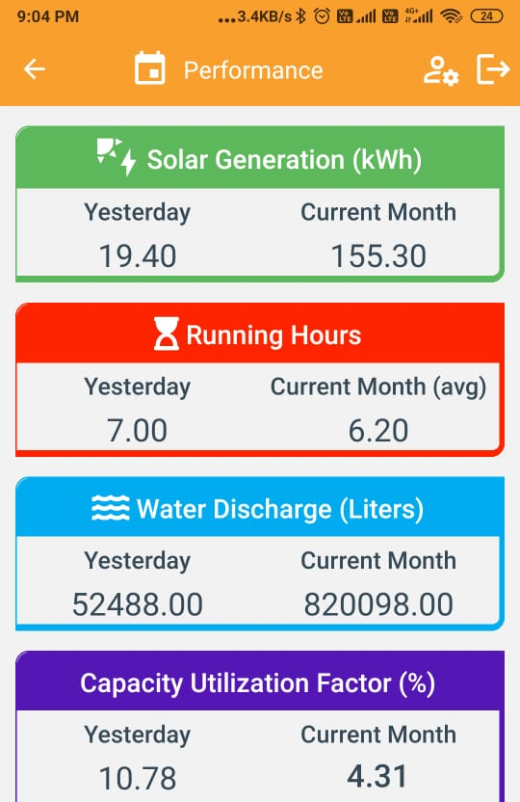
KUSUM Mobile App – Performance Analysis
Yesterday : 20th April 22
Current Month : April

Slide 12
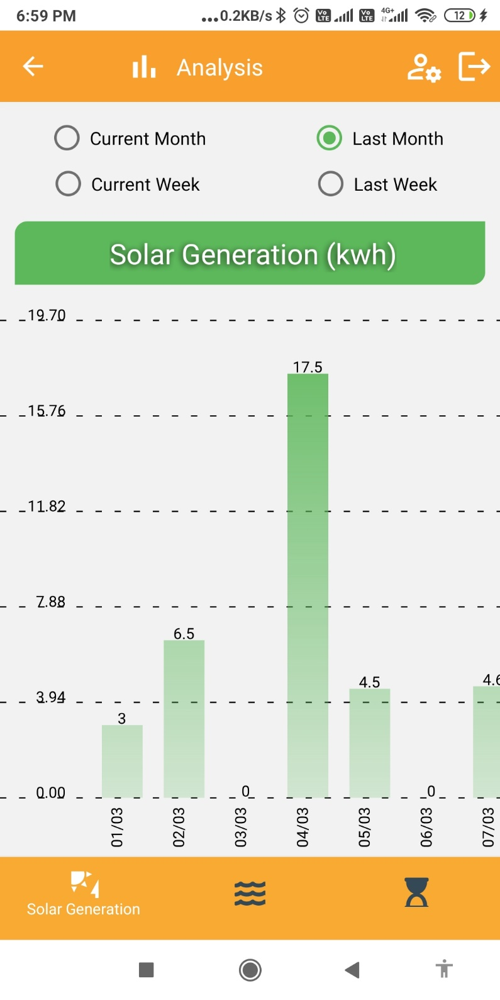
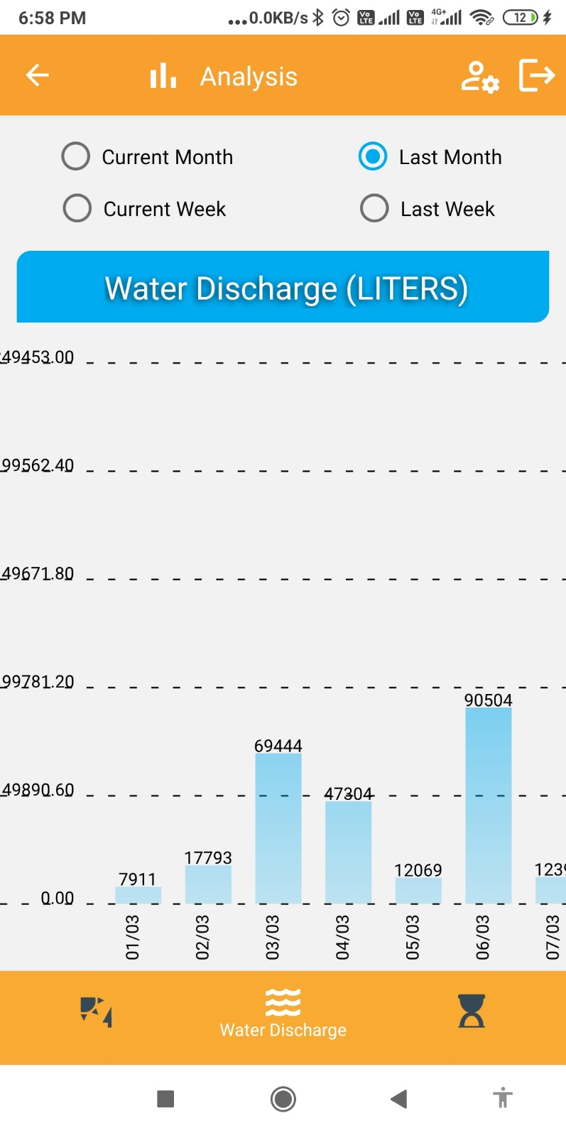
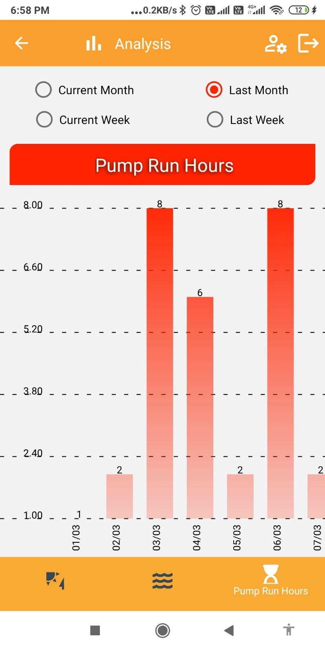
KUSUM Mobile App – Analysis of March 2022

Slide 13
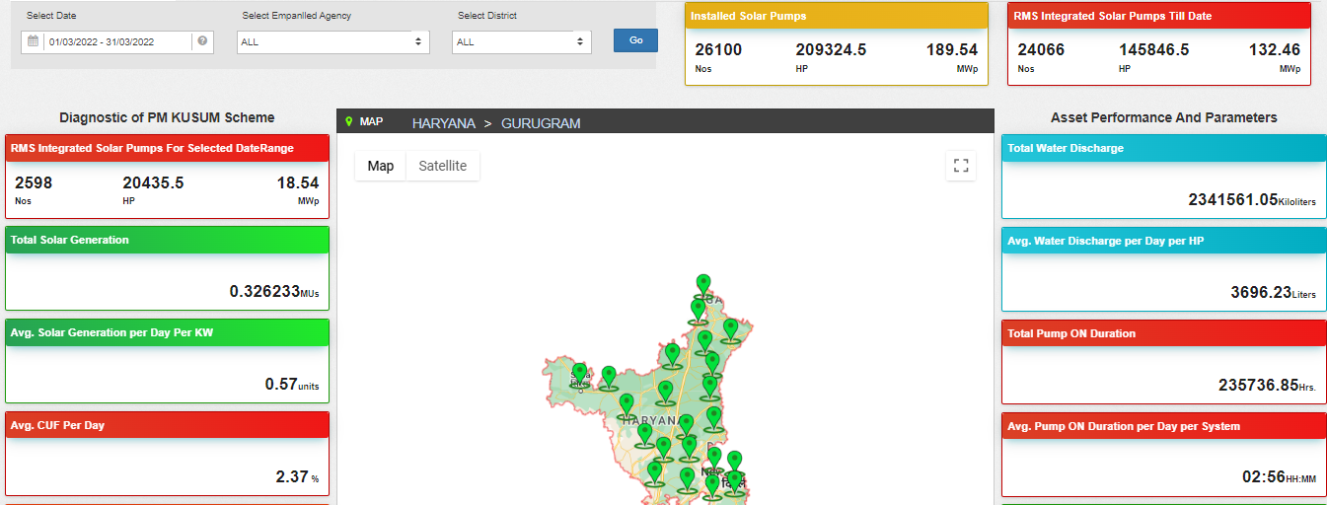
State Summary : Performance Analysis Dashboard of March 2022

Slide 14
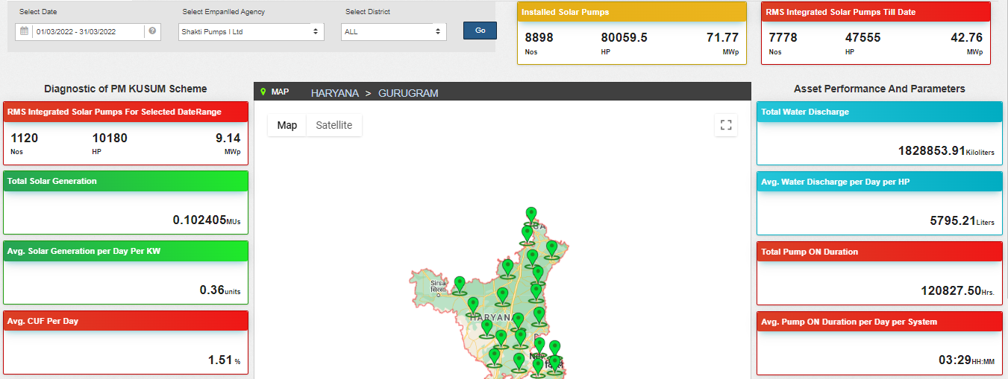
Performance Analysis Dashboard – EA View of March 2022

Slide 15
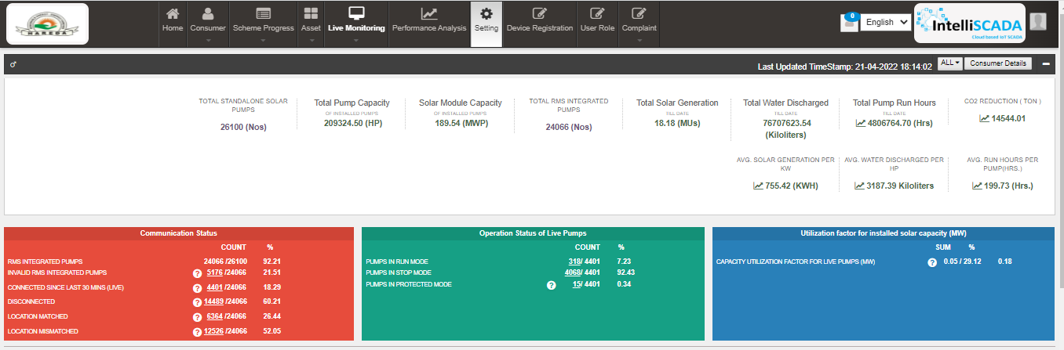
State Summary : Live Monitoring Dashboard

Slide 16
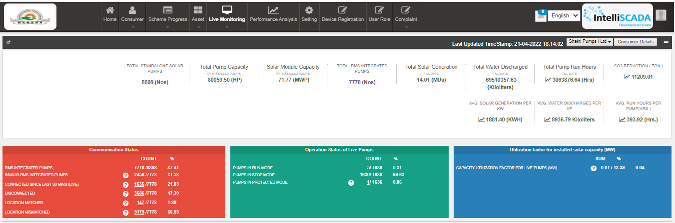
Empanelled Agency Summary : Live Monitoring Dashboard

Slide 17
Benefits to SIA as well as MNRE
Objective of Government is to improve utilization of subsidized assets where state and central government contribution is between 60-90%
Tracking of Assets – Ensuring physical availability of assets
Status of Assets – Ensuring functional availability of assets
Quality of Supply and services – Ensuring performance of assets
Usage of Assets

Slide 18
Challenges
Data Availability
Very few samples (0/10/30) in a month
Few Systems are not connected since 3-4 months
Quality of data
Irregularity in data values (sometimes zero/null)
Zero or no value of latitude, longitude sent by RMS
Must have parameter values are not sent – Energy, Running Hours, Water Discharge
Data Validation
Huge error in Correlation between Energy, Running Hours & Water Discharge
Duplicate values in different parameters

Slide 19
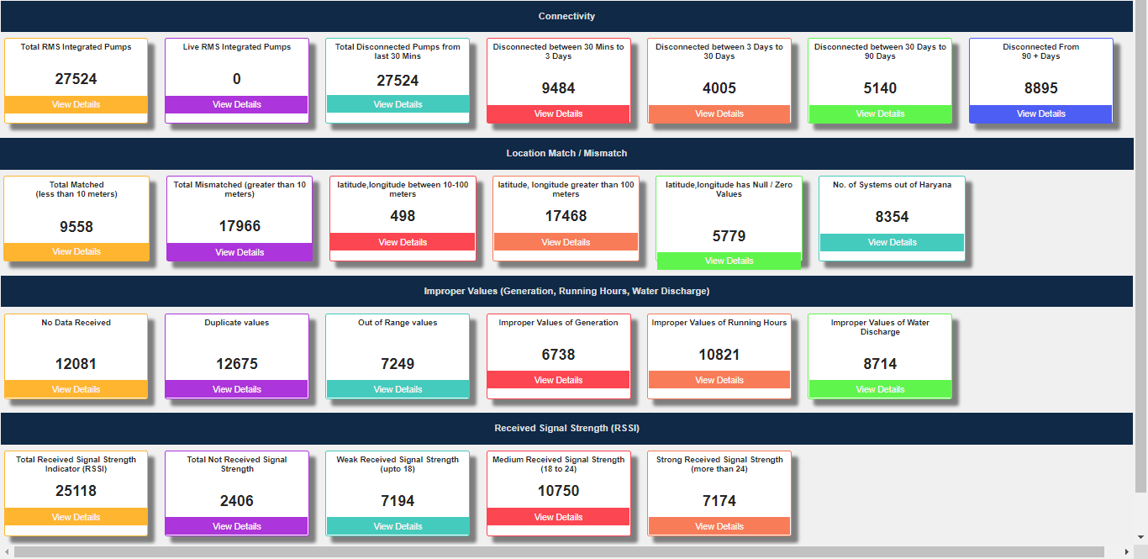
RMS Integration status - Dashboard

Slide 20
Way forward
EA need to ensure Availability of Valid Data
SIA need to ensure quality and inspection process in place for at least 3-5 samples
(Checklist already circulated)
MNRE & Software Consultancy Agency :
Educating and Handholding of EA
Coordinating with SIA for streamlining of processes
Developing various Analytics and Performance Indicators
Consumer Awareness : Mobile Application etc.

Slide 21
Questions and Answers

Slide 22
Thank You

Slide 23
Check List for Remote Monitoring System

Slide 24
Check List for Remote Monitoring System (1/2) : (For Component-B – Reference EESL Tender - EESL/06/2020-21/SWPS/1-10HP/Off Grid/202101032)
Sr. No | Specification | Purpose | Reference Clause of Tender EESL/06/2020-21/SWPS/1-10HP/Off Grid/202101032 | Method for Evaluation
1 | GPS Module with less than 10 meter horizontal accuracy | To track the location of Pump | Page no 103 Clause 2.d | Check for Geo Location accuracy on mobile application
2 | Local Device communication Pump Controller – UART/RS485 MODBUS RTU | To communicate with Local Drive (Meter, Inverters and string combiners etc.) | Page no 104 Clause 4.a.i | Check for Parameters availability at local level against MODBUS Registers
3 | Remote Connectivity : GSM/GPRS/2G/3G/4G | To communicate with State Platform remotely | Page no 104 Clause 4.a.ii | Connect RMS with State Server using SIM card
4 | Local Connectivity: Ethernet/Wi-Fi/Bluetooth | To retrieve locally store data and update configuration | Page no 104 Clause 4.a.iii | Connect mobile application to RMS and check for data on parameter monitoring page
5 | Sensor Connectivity: 2 Analog Inputs with 0.1% FSR accuracy and 2 Digital Inputs | To integrate sensors such as flow transmitters, level sensors, moisture sensors etc. | Page no 104 Clause 4.a.iv | Connect Flow transmitter analog input sensor. Check for 0.1% accuracy and data availability of flow rate on State portal
6 | Provision to remotely operate pump from state Level Platform or Farmer Mobile Application Push Data on Events Command on Demand | To save ground water farmer shall be able to turn on and off pump remotely To notify pump on off events and alarming conditions immediately | Page no 104 Clause 4.a.v Clause 4.b.i Clause 4.b.iii | Turn on or off the pump and check for within 1 minute status update on State portal

Slide 25
Check List for Remote Monitoring System (2/2) : (For Component-B – Reference EESL Tender - EESL/06/2020-21/SWPS/1-10HP/Off Grid/202101032)
Sr. No | Specification | Purpose | Reference Clause of Tender EESL/06/2020-21/SWPS/1-10HP/Off Grid/202101032 | Method for Evaluation
7 | Push data on Periodic Interval | To send voltage, power, energy, water discharge and other parameters on periodic interval | Page no 105 Clause 4.b.ii | Check for the periodic data updates on State portal at every 5 minutes
8 | Configure periodic interval | To update data communication frequency with server | Page no 106 Clause 4.g | Send command from State portal to update the communication frequency and check on portal
9 | Communication Protocol : IoT - MQTT | To ensure smooth and faster integration between RMS and State Level Solar Energy Data Management Platform | Page no 214 to 236 | Connect Remote Monitoring System with Device Registration Platform of State Portal and Verify all Parameters
10 | Topic Structure and Handshaking with Server
11 | Encryption
12 | Authentication
13 | Authorization
14 | Message Formats and List of Parameters
15 | Units of Parameters

Slide 26
Few Observations related to Existing data available from RMS

Slide 27
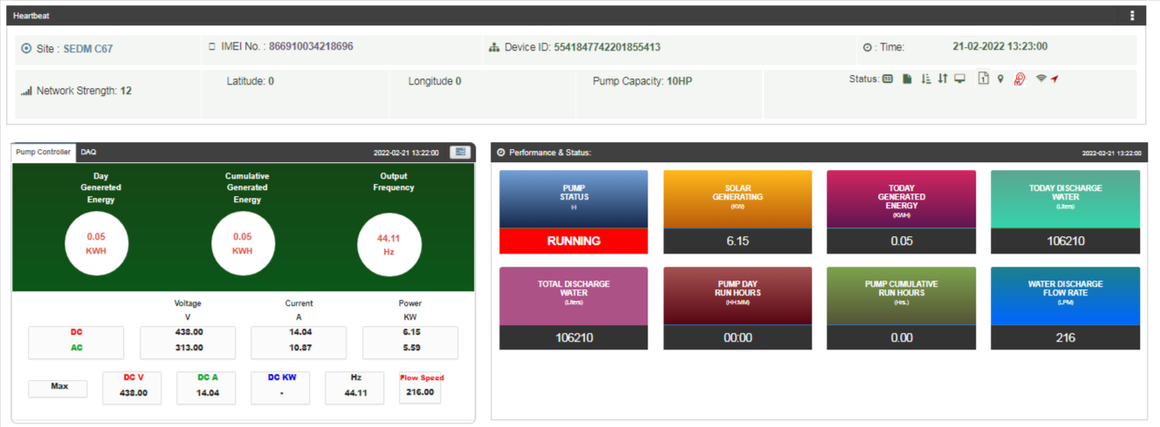
Observation 1 : Zero Value of Latitude, Longitude sent by RMS

Slide 28
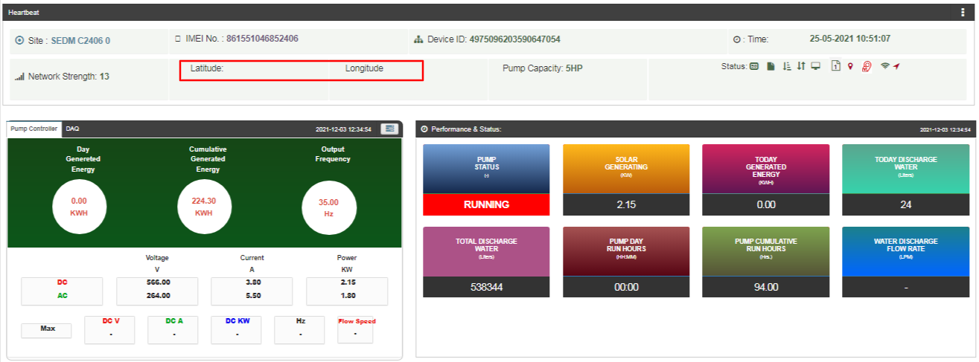
Observation 2 : No value of Latitude, Longitude sent by RMS

Slide 29
Observation 3 : Other observations related to Lat, Long
It has been observed that Latitude & Longitude captured by RMS System of few EA are not realtime
Wrong location – other state/other country
Accuracy of the 200m-10000m
Irregularity in data values (sometimes zero/null)
Manipulated preprogrammed values
Reasons
Data Entry Mistake in case of RMS is configured with Static Preprogrammed lat,long values
Use of Cell triangulation method which is inaccurate as well as irregular
Data routed through Empanelled Agency server and manipulated values are sent to state SEDM
Solution
Use of GPS Module/GPS Services with less than 10 meter horizontal accuracy

Slide 30
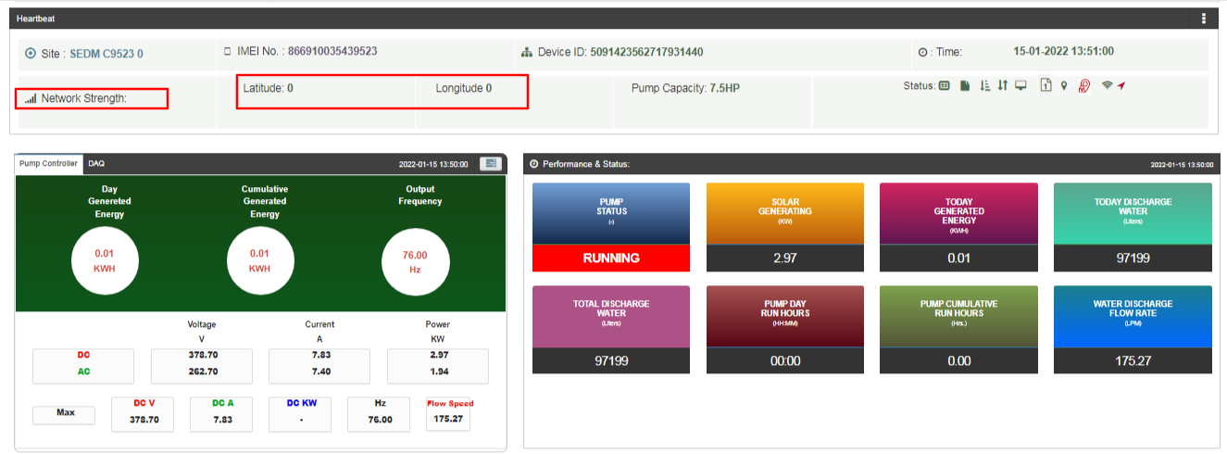
Observation 4 : No value of RSSI (Signal Strength) sent by RMS

Slide 31
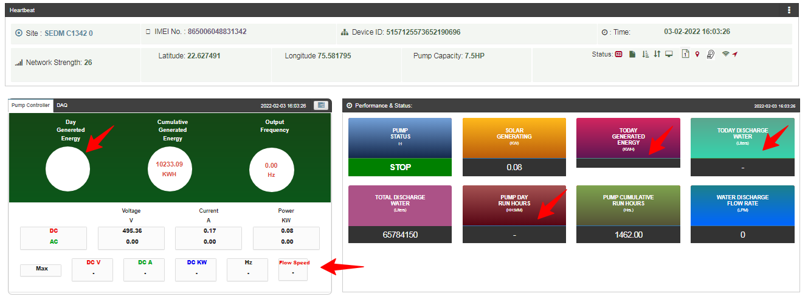
Observation 5 : Some parameter values are not sent by RMS

Slide 32
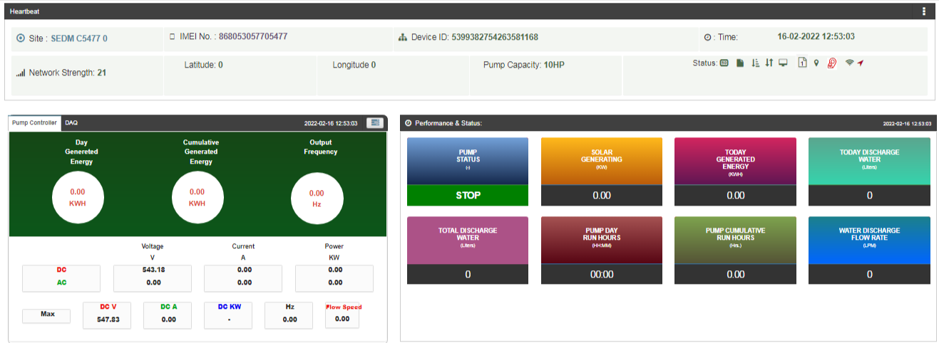
Observation 6 : Wrong/Zero data value sent by RMS

Slide 33
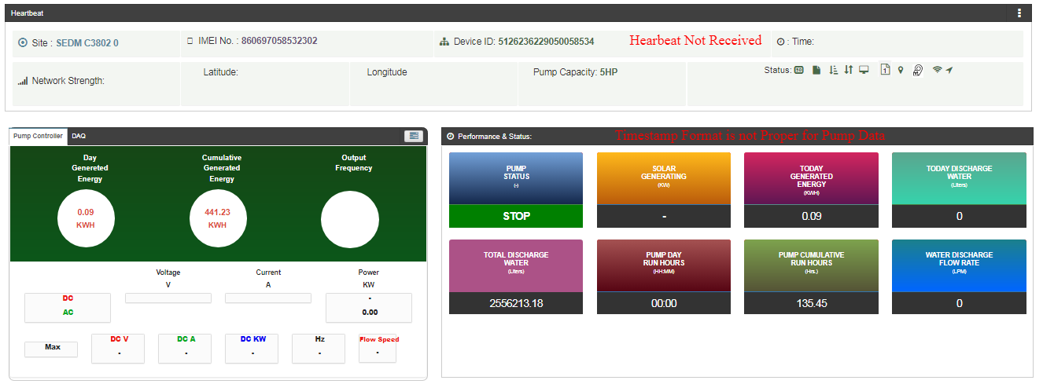
Observation 7 : Complete RMS Health related message is not sent by RMS

Slide 34
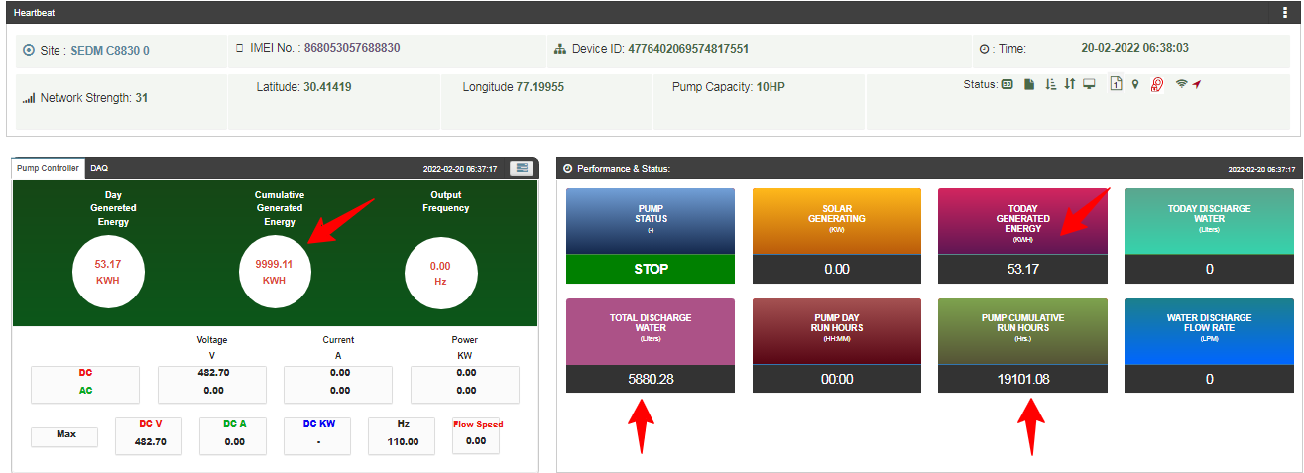
Observation 8 : Inaccuracy of available data
Huge error in Correlation between Energy, Running Hours & Water Discharge

Slide 35
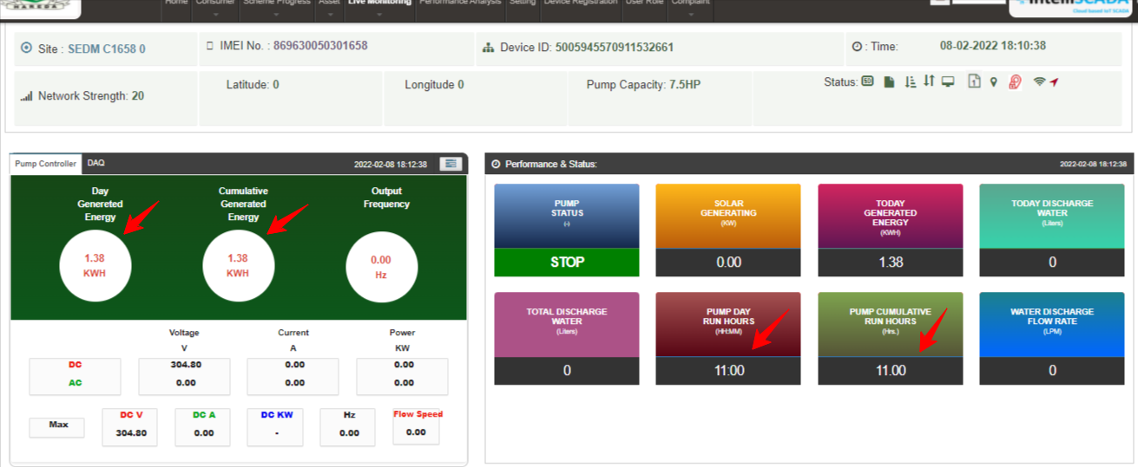
Observation 9 : Duplicate values in different parameters

Slide 36
RMS : Critical Parameters
Latitude & Longitude – To track pump location – To be displayed on dash board as well as Farmer Mobile Application
Energy Generation – To calculate %CUF
To be displayed on dash board as well as Farmer Mobile Application
Running Hours – To calculate usage pattern with crop, area, farm size –
To be displayed on dash board as well as Farmer Mobile Application
Pump Status – Running / Stop / Fault - To be displayed on dash board as well as Farmer Mobile Application
To be displayed on dash board as well as Farmer Mobile Application
Water Discharge (at least 5-10% Accurate)– To correlate Pump Size, Head, Energy Generation, Running Hours, Crop
To be displayed on dash board as well as Farmer Mobile Application

Slide 37
Poor Data Availability
Ideally RMS should be online during sunshine hours
It has been observed that very few samples (0/10/30) in a month are captured which restricts further analysis of the working condition of the pump and its performance.
RMS provides data only when pump is running
- RMS to be powered up from input DC supply not from output voltages
Few Systems are not connected since 3-4 months
SIM related Issues : recharge, ISP Selection etc.

